Slide 1
Health Research Classification System: Coder Training Course
November 2015
Dr. James Carter, MRC
Notes:
Hello this is a presentation about the Health Research Classification System or HRCS.
My name is Jim Carter and I was the project manager for the latest UK Health Research Analysis in 2014
With the report’s publication I now look after the HRCS on behalf of the HRAF, directed by the UKCRC.
Don’t worry if you don’t know who those groups are… this training course is designed to explain both the history and structure of the system.

Slide 2
Structure of the Presentation
Background (40 mins)
Where the HRCS came from
What impact it has had
Who is using it now
Understanding the System (30 mins)
How the HRCS is structured
What it can and cannot do
How to use it in practice
Notes:
This presentation is divided into two parts
Firstly I will cover some background to help you understand what the system is and does
In particular I will describe the system’s origins in previous health research analysis reports in the UK
Describing the results of such analyses is often the best way to communicate the purpose and structure of the HRCS system for the first time
In the second half I will review the structure of the system in detail and how it is operated in practise
This will also include describing access to some essential resources such as the HRCS Online website
In total this will take just over one hour to achieve a basic background and understanding of the HRCS
After this session you should understand the basics but it is recommended that you study a range of examples of practical coding work before undertaking any coding yourself

Slide 3
Health Research Classification System
Background
Notes:
So as indicated I am going to start with the origins, early results and initial impact of the HRCS

Slide 4
UKCRC Partners
Notes:
The HRCS began with a partnership organisation called the UK Clinical Research Collaboration or UKCRC which was set up in 2004
Two major reports had been published saying that the UK needed to act to integrate and improve clinical research
The slide shows the logos of the founding organisations that came together to address that aim
They are the major stakeholders that influence clinical research in the UK.
They include all government and charity funders, industry bodies, patient and public representatives, regulatory bodies, scientific and professional bodies, devolved governments and health services

Slide 5
UK Health Research Analysis
Aim - Develop a coherent approach to funding health research
Up until then no national picture of UK health research
Evidence base of current funding patterns
Analysis conducted by UKCRC Secretariat on behalf of funders to map UK Health research portfolio
Notes:
One early decision by the UKCRC partners was that there was a need for a national picture of health research in the UK
This overview would provide the first accurate baseline of current national funding patterns
In particular it would allow different research funders to make more efficient decisions about their own funding in the context of funding by others.
The UKCRC Partners agreed that one of the first tasks of the UKCRC should be to map this overall UK health research portfolio
This became the job of the UKCRC Secretariat team which was funded to coordinate the work of the UKCRC
The UKCRC was then led by Liam O’Toole its CEO and the analysis work was led by Andrew Speakman and Janet Valentine

Slide 6
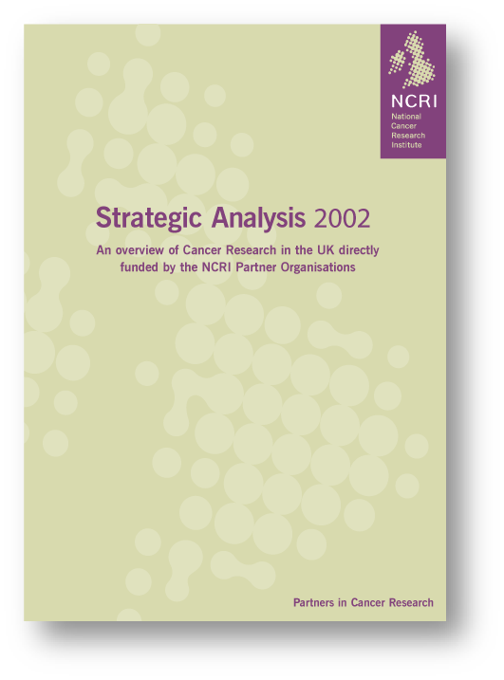
Adopted an approach based on cancer experience
National Cancer Research Institute
Partnership of government, charity and industry
Strategic Analysis 2002
Overview of UK cancer research
Based on Common Scientific Outline
Major outcomes
Joint strategy discussions
National Prevention Research Initiative
International Cancer Research Partnership (ICRP)
Notes:
The analysis was based on a similar national exercise which had already been conducted in the field of Cancer and had a major impact including important joint outcomes to address perceived problems and gaps in research activity
This was the Cancer Strategic Analysis of 2002 which was published by the National Cancer Research Institute (NCRI) – which is also a UK partnership organisation (see http://www.ncri.org.uk/)
The analysis was based on an international cancer classification system called the Common Scientific Outline or CSO
The CSO system is one of the sources for the HRCS but is also in active use in its own right by an international partnership called the International Cancer Research Partnership or ICRP (see https://www.icrpartnership.org/)
Link to report: http://www.ncri.org.uk/wp-content/uploads/2013/11/2002-NCRI-Strategic-Analysis.pdf

Slide 7
Organisations Participating
Government funding bodies
Health Departments (England, Scotland, Wales, N.Ireland)
MRC
ESRC, EPSRC, BBSRC (health or ageing relevant data)
Three largest charities
Wellcome Trust
Cancer Research UK
British Heart Foundation
Notes:
Work on the first UK health research analysis began in 2005 and the report (pictured) was published in 2006
The organisations that participated in this analysis included the 11 largest govt and charity organisations funding health research in the UK
The govt bodies included the 4 UK health departments, the Medical Research Council and the health or ageing relevant portfolios of 3 other Research Councils that have remits wider than health research – specifically in the areas of socioeconomics, behaviour and biology and engineering and physical sciences.
There were also 3 participating charities: the Wellcome Trust, Cancer Research UK and the British Heart Foundation. These 3 charities at that time had individual annual research expenditure of more than £20m pa and together comprised more than 80% of the total research spend by medical research charities in the UK
Link to report: http://www.ukcrc.org/index.aspx?o=2546

Slide 8
Methodology
Established a central UKCRC Research Database
9638 UK-based directly funded peer reviewed health research awards (programmes, projects, training etc)
Awards ‘live’ between 1st April 2004 - 31st March 2005
Designed a bespoke Health Research Classification System (HRCS)
Research Activity Codes – types of research
Health Categories – areas of health and disease
Labour intensive quality control led coding process
Notes:
To achieve the analysis, the UKCRC established a central database of the health relevant portfolios of the 11 participating funders covering a period of one year from April 2004 to March 2005.
The database eventually included details of more than 9 and a half thousand awards representing a total spend of more than £950m for the year of the analysis
To be able to compare and analyse the different portfolios on the database it was necessary to included details of funding and descriptions of the research – short scientific abstracts.
A single bespoke classification system was designed jointly by the 11 participating funders to classify the abstracts - namely the HRCS – its aim was to cover the full spectrum of health research and to answer broad strategic questions about how the money was being used.
The final classification system had 2 parts to it, Research Activity Codes which capture the type of research taking place and Health Categories which capture the area of health or disease being studied
Note that each award was classified using both parts of the system
The whole process was labour intensive taking 18 months with each award coded twice and involving contract coders and dedicated staff from the UKCRC Secretariat with input from the participating organisations

Slide 9
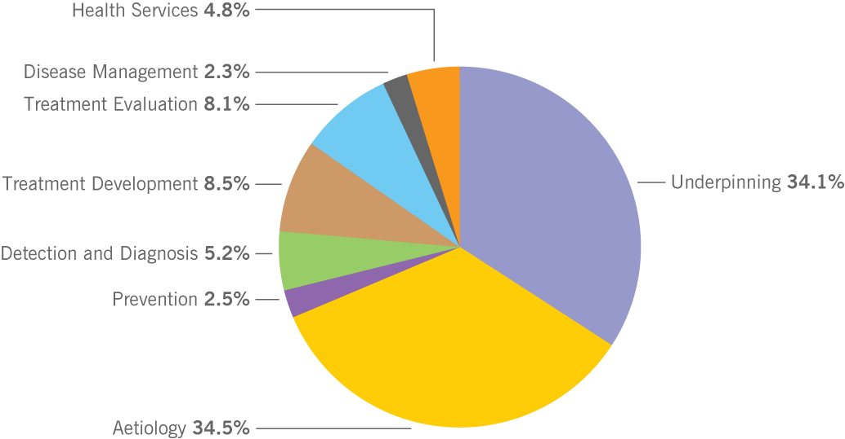
Proportion of Combined Total Spend by Research Activity
Notes:
This pie chart represents one of the main results from the analysis.
It shows the combined spend of the 11 funders classified using the 8 main Research Activity Code groups
As you can see around 1/3 of the total expenditure was classified as Underpinning. This represents anything investigating normal function - including basic biology, behaviour and socioeconomic studies
A further 1/3 of national funding was classified as Aetiology. This category includes all research on causes and development of disease. For example most of epidemiology is within this category
The remaining third of funding was divided between the other 6 Research Activity Code groups representing research at the more applied end of the spectrum
This includes the Prevention code (2.5%) which includes research on vaccines and health behaviour change for example to do with diet and smoking
The Detection and Diagnosis code (5.2%) includes research into predictive markers
Research into treatment and therapies (16.6%) includes all types of treatment from pharmaceutical, medical devices to behavioural and physical therapies and is divided into two parts within the system representing Development and Evaluation of treatments
The Disease Management code (2.3%) covers research into health management at the personal level – including issues relevant to patients and health professionals
The Health Services code (4.8%) covers research at an organisational level and includes health care delivery, policy and health economics

Slide 10
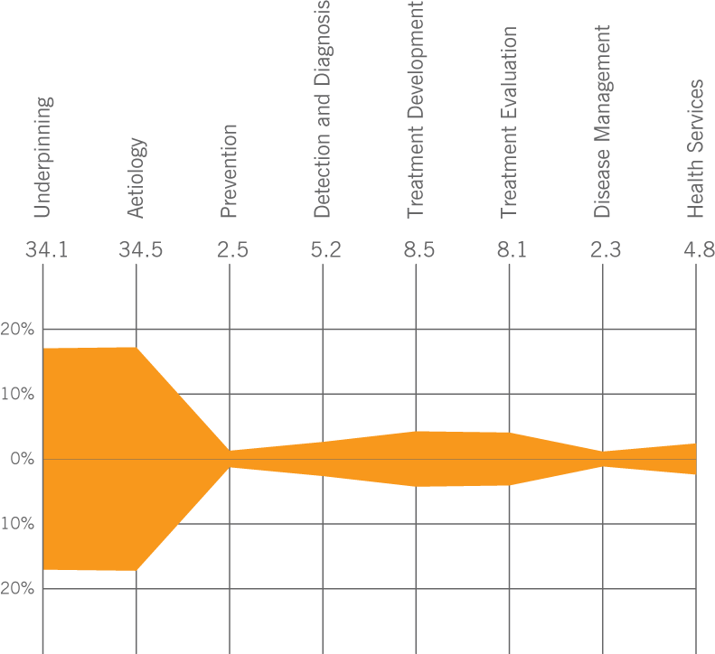
Proportion of Combined Total Spend by Research Activity – Kite Diagram
Notes:
The same data from the previous pie chart is here presented in the form of a kite diagram
The 8 research codes are distributed along a central axis and the overall percentages for each code is represented by the distance above and below the central axis (eg –Underpinning has 17% above and below the axis representing 34% as seen before)
The reason for using kite diagrams is that they produce a clear profile which is easier to compare

Slide 11
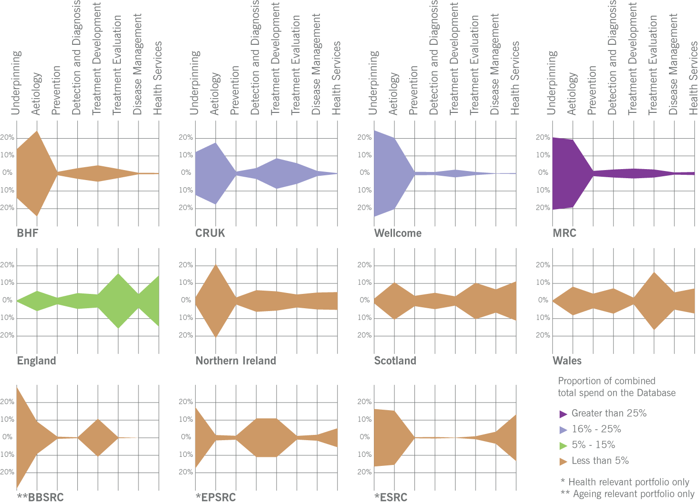
Profile of Each Organisation’s Spend by Research Activity
Notes:
In this slide the research portfolios of each of all 11 participating organisations are compared using kite diagrams.
Note that each kite diagrams represents a different size portfolio and these are colour coded to reflect these differences - for example the MRC shown in purple is the largest and represents >25% of the total spend on the database compared with eg EPSRC whose portfolio is less than 5% of the total spend on the database
Each kite represents the relative spend within that organisation and the absolute amounts are different in each case.
However the different shapes of the portfolios can be compared. You can see that in the top line the 3 charities and the Medical Research Council focus the majority of their research funding in the areas of underpinning or aetiology research
This contrasts with the 4 UK health departments in the middle line which, as might be expected, focus their research more on treatment evaluation and health services
The bottom line shows three profiles compatible with the activities of the other three research councils – for example the ESRC which has an interest both in socioeconomics at the basic end and in health services research at the applied end.

Slide 12
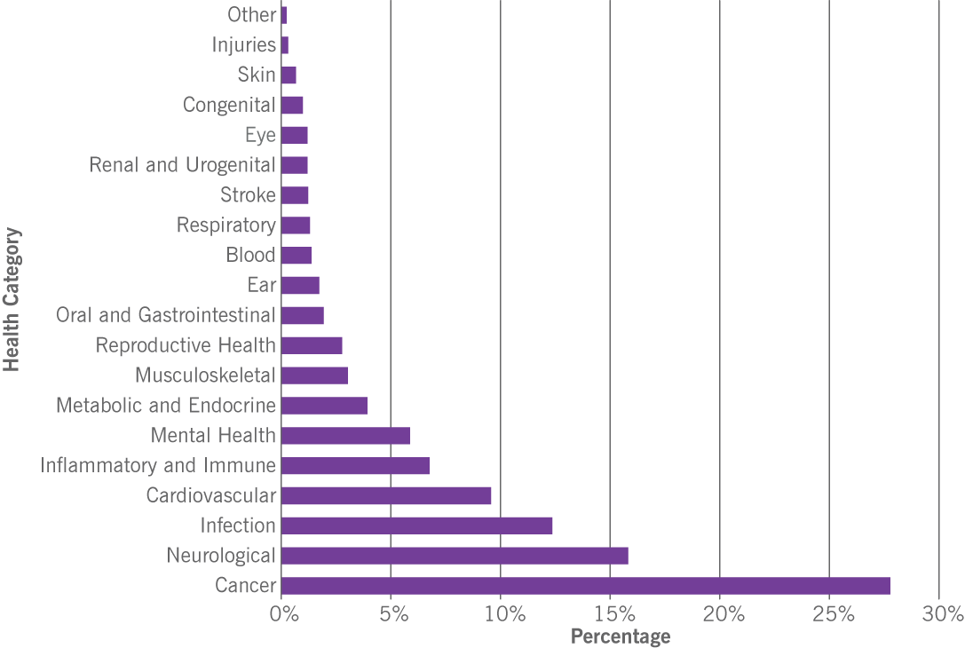
Proportion of Combined Spend on Health Specific Categories
Notes:
This graph represents another important result from the UK Health Research Analysis.
It shows the combined spend of the 11 funders classified using the Health Categories of the HRCS
Note that the figure is based on 75% of the total funding on the database which was found to be relevant to specific diseases or health areas – the other 25% was excluded because it was classified as relevant to all areas of health and disease.
The health categories are ordered according to the amount of funding in a particular area of health and disease. By far the largest amount was spent on Cancer research with the smallest spend being into research in the Other category and on injuries and accidents
In the report it is noted that around 2/3rd of the funding on specific diseases is spent in the top 4 disease areas which are; Cancer, Neurological, Infection and Cardiovascular

Slide 13
From Donation To Innovation
29 medium & smaller sized AMRC member charities
1496 awards
Published 2007
Two reports together represent majority of UK government & medical research charities’ funding (over £1 billion funding)
Notes:
Following on from the UK Health Research Analysis published 2006, which included 3 major health research charities a second analysis of charity health research funding was published in 2007
This new analysis was undertaken in partnership with the UK’s Association of Medical Research Charities
It used the same methodology and 2004/2005 time frame as previous report, but it was smaller in scale covering approximately 1500 awards (and £64 million pounds of expenditure) from 29 medium and smaller sized medical research charities
Taken together the 2 reports included 96% of the UK’s medical charity research expenditure and almost all of the government funding in health research – amounting to more than £1 billon during 2004/2005
Link to report: http://www.ukcrc.org/index.aspx?o=2219

Slide 14
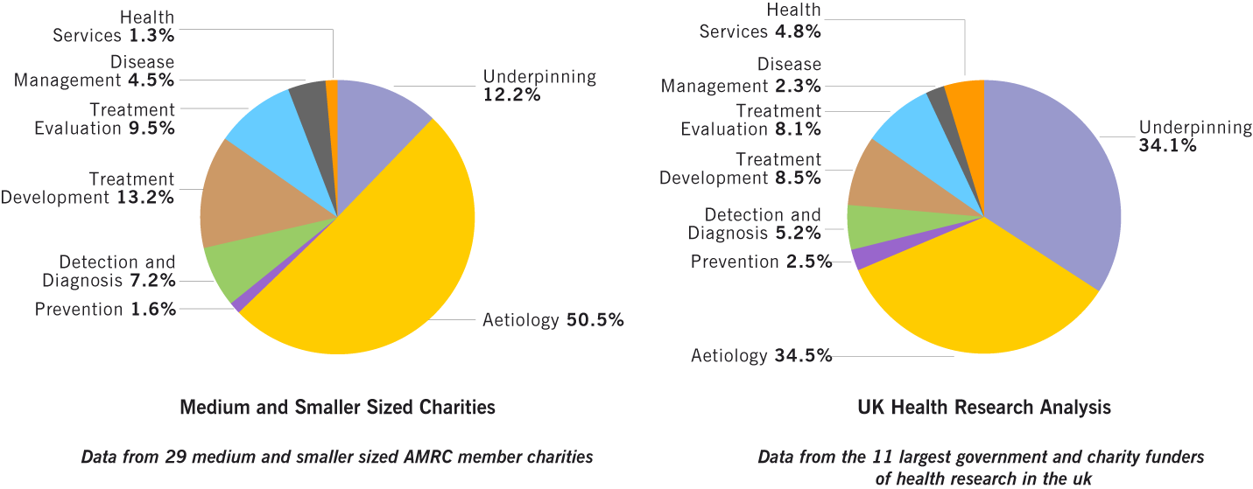
Distribution of Total Spend by Research Activity
Notes:
This slide contrasts the results from the two reports in terms of the main Research Activity Code groups
On the right are the results you have already seen from the first Health Research Analysis
On the left are the comparable results from the analysis of smaller and medium sized charities
The major feature of the charity analysis is that 50% of the total spend is in the Aetiology code group, whereas only 12% of funding is classified in Underpinning. This contrasts with the approx one third of funding found in each of these groups in the previous analysis
However this result makes sense because many of the research charities have a specific disease focus – therefore a lot of their funded research is focussed on the cause and development of disease as opposed to research into normal healthy functions

Slide 15
Impact of the Analyses and HRCS
Reports widely distributed
Evidence base used by
Individual funders
Joint planning and coordination
Research community
Classification system adopted by many UK government and charity funders
Primary data source for Cooksey Review
Notes:
These two reports were the first national scale maps of UK research activity and they had a wide distribution and impact within the UK
They provided an important baseline that was used to inform strategic planning at 3 different levels – by individual funders to help future funding decisions, to facilitate joint planning and coordination between the funders including some ongoing joint initiatives that were carried out by UKCRC, and thirdly by the research community to shape overall research proposals and activities
Several UK organisations adopted the system for internal processing and analysis – in particular it has been adopted by the two major government funders of UK health research the Medical Research Council (MRC) and the National Institute for Health Research (NIHR)
The data from the 2004/05 analysis was also used as one of the key evidence sources for Sir David Cooksey’s “A review of UK health research funding” which was tasked with advising Government of the best arrangement of public funding of health research.

Slide 16
Inter-Analysis Period (2006-2009)
Change to Funder-Led Process
Health Research Analysis Forum (HRAF)
Chair/Lead Organisation: MRC
International Workshop 2009
EMRC recommendation for international adoption
Early development of auto-coding procedures – Elsevier Team
Notes:
In the current era, control of the HRCS in the UK has been transferred from the UKCRC Secretariat to a new UKCRC partnership group called the Health Research Analysis Forum (HRAF)
This group is chaired by Ian Viney who is head of Evaluation at the Medical Research Council (see ian.viney@headoffice.mrc.ac.uk)
In 2009 there was an international workshop to introduce the HRCS to people not familiar with it and also to discuss how to facilitate and encourage its wider use internationally
The workshop was attended by 35 senior representatives of 14 different nationalities from 26 health research organisations.
Following this workshop, active interest has developed in Ireland, Scandinavia, Singapore and Hong Kong among others – this includes countries planning projects, undertaking pilot analyses, or being trained to use the system
This group is in dialogue with the European Medical Research Council which has expressed an interest in the HRCS as a common classification system
However its major activity in recent times has been to resource and publish a repeat of the UK Health Research Analysis 5 years after the original report

Slide 17
UK Health Research Analysis 2009/2010
Participants
Original 11 funders, plus Arthritis Research UK
Limited Budget
Funder led = in-house coding
Provision for external (contract) coding
BUT no quality control
Analysis (2009/2010)
12,000 awards with £1.6bn (~50% real terms increase)
New: Infrastructure Assessment, additional £827m
New: Estimation of Total UK Health Research Expenditure
Notes:
The UK Health Research Analysis 2009/2010 involved 12 participating organisations.
This includes the original 11 organisations from the 2006 analysis and Arthritis Research UK from the 2007 charity analysis (ARUK is the fourth largest UK health research charity in terms of budget)
The new analysis was based on the 2009/2010 financial year making it 5 years after the original.
It included 12,000 awards and covered expenditure of £1.6 billion.
This can be compared with the figures from 2004/2005 of around £1 billion of funding and under 10,000 awards and showed that the UK budget for health research had risen significantly over the 5 year period
The methodology and coding system for the second analysis was the same, although budgetary constraints meant that coding was not done twice and some coding was undertaken by the organisations supplying the data
The report was published in 2012 and is available from the UKCRC and Medical Research Council websites
Link to report: http://www.ukcrc.org/index.aspx?o=3643

Slide 18
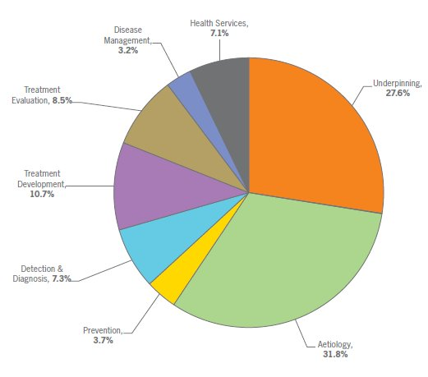
Proportion of Combined Total Spend by Research Activity (2009/2010)
Notes:
This slide shows one of the main result figures from the latest health research analysis published in 2012 showing the main Research Activity Code groups
In the new analysis it was found that the Underpinning and Aetiology groups still represent the majority of national spending - but a slightly smaller amount is now found in Underpinning since 2004/2005 (one quarter as opposed to one third of funding)
It was found that spending on Prevention is still small in absolute terms but had more than doubled since 2004/2005
Relative spending also rose in all the other more applied areas of the code spectrum (apart from Treatment Evaluation)
In the report you can read further interesting details on changes in the spending profiles as classified using Health Categories
In particular it was found that there were increases in areas such as Respiratory and Oral and Gastrointestinal which were had relatively low spending in 2004/2005
There were also changes in the well funded health categories, such as Cancer, Infection, Neurological and Mental Health

Slide 19
UK Health Research Analysis 2014: Aims
Improve speed of report production
Greater availability of data in more easily extracted format
The majority of awards already coded
Increase number of participating organisations
More medium/small charities and other public funders
Improve consistency and quality of coding
Review HRCS, update guidance and standardise approach
Make the data openly accessible
Considerable interest in further use of UK HRA data
Pre-agreement of HRAF members to release full public dataset
Notes:
The second UK Health Research Analysis was also widely disseminated across the research policy community.
Since publication in 2012 the use of coding for internal reporting has also increased.
Therefore when the proposal to produce a third report, marking 10 years of the HRCS analyses the aim had shift from simple replication to a wider focus.
<work through the bullet points here>
NOTE 1: Improving report production speed was important – it took over two years from initial data collection to publication for the 09/10 report.
One feature that did help this time around was provision for a dedicated project manager for the analysis, to coordinate activities and be the primary author of the analysis and report.
NOTE 2: With greater dissemination of the report, and to follow on from the Donation to Innovation results, there was a drive to include more data from other (non-HRAF group) sources
NOTE 3: The first report had a dedicated secretariat to check all awards, the second had no quality control.
Therefore a key aim for the third report was to assess the current state of coders and coding – numbers and accuracy
This would then feedback into a review of the HRCS. This had three aims;
(a) to provide improved guidance to coders to ensure future coding would be more replicable
(b) to update the HRCS to cover new discoveries/technologies or areas of research not sufficiently covered or unknown in 2004.
(c) to ensure the HRCS remains ‘fit for purpose’ in its current state or whether the system itself requires formal review and changes.
NOTE 4: The release of more data than previous analyses serves a dual purpose
It increases the cost-effectiveness of the project by providing a dataset that can be reused for other sub-analyses.
Encourages the Government view of open data and the current momentum in the research community of the benefits of sharing funding data
In the same way that shared research data can have benefits to health research, shared funding data has the potential to allow:
inter- and intra- funder benchmarking for strategic planning / policy approaches
Better identify opportunities for collaboration between funders
Identification of new areas of funding need

Slide 20
2014 Results – Total Analysis Spend
Increased participation (64 funders)
17,021 awards - £3.01bn spend
~£2bn on direct awards (‘projects’)
~£1bn on indirect awards (‘infrastructure’)
Increase in 5 and 10 year reporting
Rate slowing (CAGR 8.2% 04-09, 1.4% 09-14)
Notes:
This slide provides some of the headline results from the 2014 analysis
Number of funders increased from the original 12 HRAF funders to 64
The majority (48) were from AMRC member medium/smaller charities, including Diabetes UK,
The remaining 4 new funders were public organisations; NERC and AHRC from the research councils, Innovate UK and NC3Rs.
Inclusion of new funders helped increased the funding coverage to £3bn, although the HRAF group still provide the majority of funding (~94%).
Funding amount was higher than previous years in real terms
New funders accounted for approximately £100m in additional direct awards.
HRAF group provide almost all infrastructure spending.
One key finding was that the rate of increase, measured by Compound Annual Growth Rate (CAGR) showed that while health research funding had still increased over the ten year reporting period, the rate of growth slowed from 8.2% between 2004 and 2009 to only 1.4% between 2009 to 2014.
The most likely cause was the global economic downturn.

Slide 21
2014 Results – Health Categories
Notes:
This slide shows the comparison of changes in health category proportions (percentages of total spend) between the three reports.
Health category proportions remain largely static over the last ten years
Largest contributions to Generic Health and Cancer
Rise in infection – potentially related to increased funding for research into Anti-microbial resistance (AMR)
Decrease in Neurological, but increase in Mental Health may suggest a transition on how research into mental illnesses occurs
As with research activities, it’s important to note than almost all categories have seen a real terms increase in funding in ten year period. The one exception is ‘Ear’.

Slide 22
2014 Results – Research Activities
Notes:
This slide shows the comparison of changes in research activity proportions (percentages of total spend) between the three reports.
In contrast to health categories, we observed a consistent change in funding of research activities
We observed that funding provided to early stage or ‘basic’ research in Underpinnning and Aetiology decreased
Whereas the funding to areas considered ‘translational (in particular Prevention, Detection and Treatment Development) increased
These changes are indicative of strategic decisions, in light of recommendations by the Cooksey Review and other to enhance the funding of translational research
For example, schemes like the National Prevention Research Initiative direct promotes research into prevention.

Slide 23
2014 Results – Charity / Public Distribution
Notes:
This slide depicts the spend for 2014 by research activity, subdivided by the type of funder (charity, research council or other public Government funder).
In a new addition to the UK Health Research Analysis, the 2014 report also included a division of the health research spend by the type of funder.
Via this method, we see that:
Research Councils primarily provide the majority of basic research funding (~60% of Underpinning, 50% of Aetiology)
Medical Charities also support basic research, particularly causal elements of disease (~50% Aetiology)
Charities also support a large proportion of early development research (half of Detection and Treatment Development)
Other public funders, principally the Department of Health and Devolved Administrations, concentrate their funding in a clinical setting, via Treatment Evaluation, Disease Management and Health Services.
This particular analysis has proved to be most popular, with many participating funders commenting on the distribution as a sign of complementarity, not double funding of research.

Slide 24
Future of HRCS
Continue working to International Standard
Improve Coding Reliability
Increase reporting efficiency (auto-coding)
Begin plans for next analysis…?
Notes:
The third report on the UK Health Research Analysis was published in August 2015.
To continue the momentum generated from this work, we are continuing to develop the HRCS and improve the knowledge and coding capacity of the UK health research sector.
Of particular interest are the areas listed on this slide:
NOTE 1: The HRCS is now routinely used across most of the main UK health funders, for both internal reporting and for the production of quinquennial reports.
The system is also in continuous use in Norway and Sweden, and we are keen to see the HRCS adopted internationally to allow cross-country comparative analyses
NOTE 2: To become internationally recognised requires continuous review and assessment of the system, including it’s reliability in practice.
As a result we are in the process of running further review sessions with specialist working groups (e.g. experience coder workshops) to identify those codes/topics perceived as ‘difficult to code’
NOTE 3: At present the system is labour intensive, requiring a continuous pool of trained coders to provide the necessary coding information for analysis.
Given the difficulty (both in staff training and reliability of coding) and the inherent cost involved, we are also pursuing more automated processes
Auto-coding would allow for wider application of the system (e.g. on all applications, not just awards, or publications) and potentially allow for a more reliable application of coding.
However this process is still in very early development stages, and will take some time to implement.
It is also unlikely to completely supercede all manual coding – the most likely outcome would be a pre-filtering system to reduce the workload for manual coders.
NOTE 4: All of this will feed into plans for the next UK analysis, due in 2019.
Initial planning and proposal submission to the UKCRC likely in 2016.

Slide 25
Health Research Classification System
Understanding the System
Notes:
That completes my overview of the HRCS in terms of its origins and the uses it has been put to for the strategic analysis of health research in the UK.
In the second half of this talk I am going to review the purpose and structure of the HRCS and then cover how to use the system in practice

Slide 26
What is the HRCS?
A system for classifying and analysing health and biomedical research funding
Designed collaboratively by a range of funders for the following purposes:
To cover the full spectrum of all types of research across all areas of health and disease
To provide a single stable common system allowing meaningful comparisons across time and between different portfolios
To answer strategic questions about investment
To give a “broad brush” overview of funding patterns
Notes:
The HRCS was designed collaboratively by it’s the original research funders to summarise the full range of their common interests in health research
This means that by design it has a wide coverage to allow for comparisons across a range of organisations and settings
Another key aspect is its stability over time – to ensure that any comparisons are meaningful
Fundamentally it has a particular purpose at the strategic and national level where it gives a readily assimilable summary overview of the funding directly associated with particular health research activity
However you should note that the system is not intended to answer all possible questions about health research funding

Slide 27
Structure of the HRCS
Two dimensional system
Health Categories
Research Activity Codes
Health Categories
All areas of health or disease
21 individual categories
Based on WHO International Classification of Diseases
Research Activity Codes
All types of research activity from basic to applied
48 codes in 8 groups
Based on cancer Common Scientific Outline
Notes:
During the rest of this presentation it will help if you have copy of the HRCS system definition booklet (pictured) to refer to
As indicated previously the HRCS has 2 coding dimensions and each award is coded using both dimensions
In the first dimension there are 21 Health Categories covering all areas of health and disease
The Health Categories are based on the well known World Health Organisation ICD codes
The other dimension of the system is the Research Activity Codes which cover all types of research activity from basic to applied
As we saw in the first half of the presentation there are 8 main Research Activity Code groups but these are based on 48 underlying individual codes which are assigned to an award when coding
And as seen previously the Research Activity Codes are based on the international cancer classification system known as the Common Scientific Outline or CSO
Link to HRCS booklet: http://www.hrcsonline.net/sites/default/files/HRCS_Document.pdf

Slide 28
Key Features of the HRCS
Coding is based on the main research objective
Not a keyword system
Does not capture all potential downstream outcomes
Complements existing coding systems
Fit for purpose
Coding is linked directly to associated funding
Codes based on lifetime of the award
Exact percentages with every code
But is not a financial audit tool
System provides a broad overview of the centre of gravity of research
An aggregate population summary
Fine grained expertise not required
Notes:
These are some key features of coding using the HRCS
Firstly coding is based only on the main aim or objective of the research
Which means that it is different from a keyword tagging system which would capture many aspects of the work and that can be used for example as a search tool or finding aid
It also means that the context, downstream consequences or future impact of the research are sometimes not relevant to coding
The system is fit for a particular purpose – different coding systems are required to capture other aspects you may be interested in
Secondly there is a direct link from the coding to the funding – to money
HRCS codes are tied to the aim of the award during its funded period and the codes should summarise how the research funds will be or were used
Additionally each code gets assigned a percentage so that associated funds can be apportioned to appropriate parts of the system
However note the system is not a financial audit tool as not all research funding can be tied to specific research objectives that can be analysed using the HRCS system - for example, general supporting infrastructure or capital funding
Finally, as indicated previously, the system is a strategic tool which provides an overview
When applying individual codes it helps to bear in mind that the results will be aggregated and consider where the current award might best fit overall
Similarly when confronted with a detailed technical abstract, remember this can often be a distraction, a simple lay summary can often be a better indication of where the research fits in the HRCS

Slide 29
Key Aspects of HRCS Coding Process
Tried and Tested
Accumulated experience began in 2005
Several major analyses, thousands of awards
Range of organisations, award types and settings
Stable and Consistent
HRCS is openly available but not for alteration
Simple reproducible rules – equal proportions, minimum number of codes
Value lies in ability to compare over time and between settings
Notes:
These are some of the advantages of the HRCS
Firstly it is a tried and test system, which as we saw, first began in 2006
There is accumulated experience covering major research organisations and thousands of awards
This experience is reflected in the recommended procedures captured in this training and it gives confidence that the system can adapt to new circumstances as they emerge
A second key aspect is that it is a stable system which is not changing
As we shall see, the system is applied using some simple reproducible rules – such as assigning minimum numbers of codes and assigning them in equal proportions
Some of these rules can be debated and may seem arbitrary but they are a key part of the process to ensure consistency and standardisation and enable meaningful comparisons to take place over time and between settings

Slide 30
HRCS Online website
Makes all existing information and resources accessible
Overarching aim to promote sustainability of the system
Guidance for naïve users wanting to learn how to use the system
Reference source for experienced users
Provides further contextual help, summaries and linkages
Notes:
Another key aspect of the HRCS is the associated HRCS Online website (www.hrcsonline.net) which was set up to sustain the system in the long term and to promote it to different audiences e.g. internationally
It is intended to hold all relevant HRCS information and to provide both guidance for new users and also act as a reference source for experienced users
There is contextual help and linkage throughout – for example if you want to explore the origins of the system, each Health Category is linked to the relevant WHO ICD code and each Research Activity Code to the appropriate code in the Common Scientific Outline

Slide 31
Health Categories
Blood
Cancer
Cardiovascular
Congenital Disorders
Ear
Eye
Infection
Inflammatory and Immune System
Injuries and Accidents
Mental Health
Metabolic and Endocrine
Musculoskeletal
Neurological
Oral and Gastrointestinal
Renal and Urogenital
Reproductive Health and Childbirth
Respiratory
Skin
Stroke
Generic Health Relevance
Other
Notes:
This slide is a list of the HRCS Health Categories
There are 21 categories of which 19 are specific to particular health areas
Full details on all the categories are available in the HRCS definition booklet and on the HRCS Online website
However in the next few slides I will review some key points to note about particular health categories from this list

Slide 32
Notes on Health Categories (1)
Cancer
all types - not coded by site e.g. lung cancer
Cardiovascular
includes atherosclerosis
Congenital Disorders
multiple syndromes - excludes single focus syndromes like congenital heart disorders
Infection
all types - not coded by site e.g. respiratory tract infections
Inflammatory and Immune System
about immune system (not just immune response) - includes rheumatoid arthritis
Mental Health
includes normal behavioural and cognitive function – and all abnormal conditions defined by behaviour
Notes:
The Cancer category covers all type of cancer – they are not differentiated by site of action – studies of lung cancer are coded as Cancer and the respiratory aspect is not captured
The Cardiovascular category is not just studies of the heart, it includes atherosclerosis and other disorders of blood circulation
The Congenital Disorders code covers inherited disorders with multiple types of disease and condition such as cystic fibrosis – it excludes inherited disorders with a single focus, such as congenital heart disorders
The Infection category applies to all types of infection – like the Cancer code, infections are not differentiated by site of action
The Inflammatory and Immune code is designed for studies of the immune system – it should not be applied simply because a disorder has an immune response component, which will be the case in many conditions
The Mental Health code includes all abnormal conditions defined by behaviour but also normal behavioural and cognitive function

Slide 33
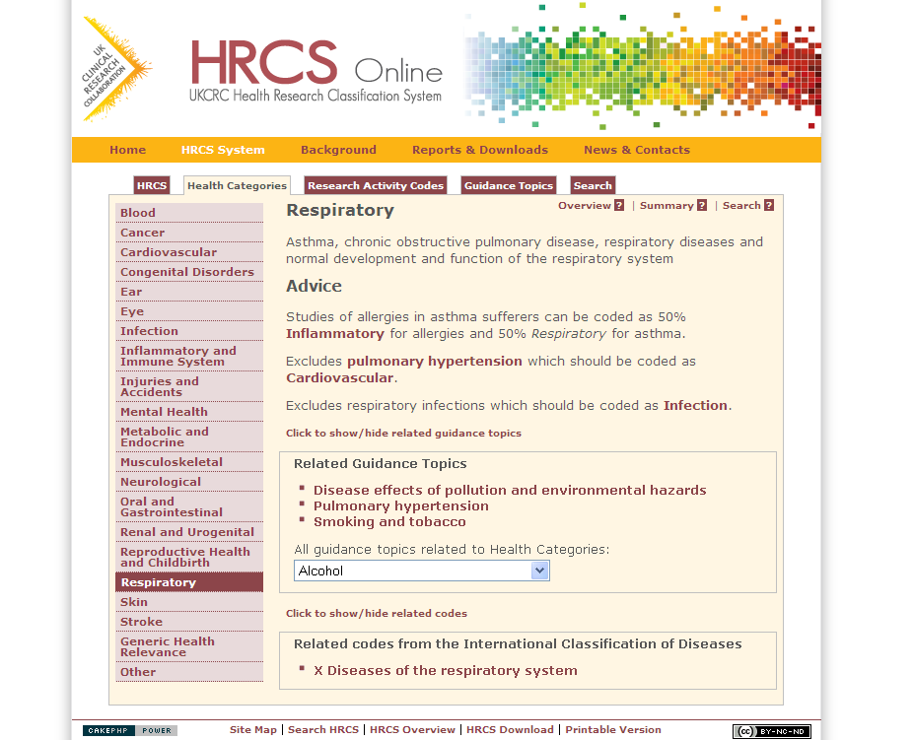
Notes on Health Categories (2)
Musculoskeletal
includes osteoarthritis
Neurological
about brain function and ‘wiring’ – includes BSE and dementias
Reproductive Health and Childbirth
includes all aspects of pregnancy and the new born
Respiratory
includes asthma
Notes:
The Musculoskeletal code includes osteoarthritis but not rheumatoid arthritis which belongs in the Inflammatory and Immune category
The Neurological code includes studies of brain function and brain interconnections – it includes the dementias and also BSE = Bovine Spongiform Encephalopathy
The Reproduction category includes research into all aspects of pregnancy, birth and the newborn
The Respiratory category is about lung function and includes studies of asthma

Slide 34
Notes on Health Categories (3)
Generic Health Relevance
all areas of health or general health
Or >5 Health Categories
Other
A few very specific areas including Gulf War syndrome and chronic fatigue syndrome
Not a dustbin category
Note: Each category includes normal/healthy and disease processes
Note: Categories are not always deducible from causation, symptoms, or site of action
Notes:
Finally there are two health categories which are not specific to a particular health area
The Generic Health Relevance category is applied if research is relevant to all areas of health or to health in general
It should also be applied if the research is found to be relevant to more than 5 Health Categories
The Other category has a specific purpose and should never be used as a dustbin category – ie when you are not certain which code to apply
It should only be used in a few very specific circumstances where no other code will do
In the UK it has been used for studies of Gulf war syndrome and chronic fatigue syndrome where there is controversy about the nature of the disorder
In general there are 2 important points to note about the Health Categories:
1. Apart from Cancer and Infection, Health Categories include studies of both normal healthy function as well as disease processes
2. The appropriate categories cannot always be deduced from knowledge of causation, symptoms or site of action

Slide 35
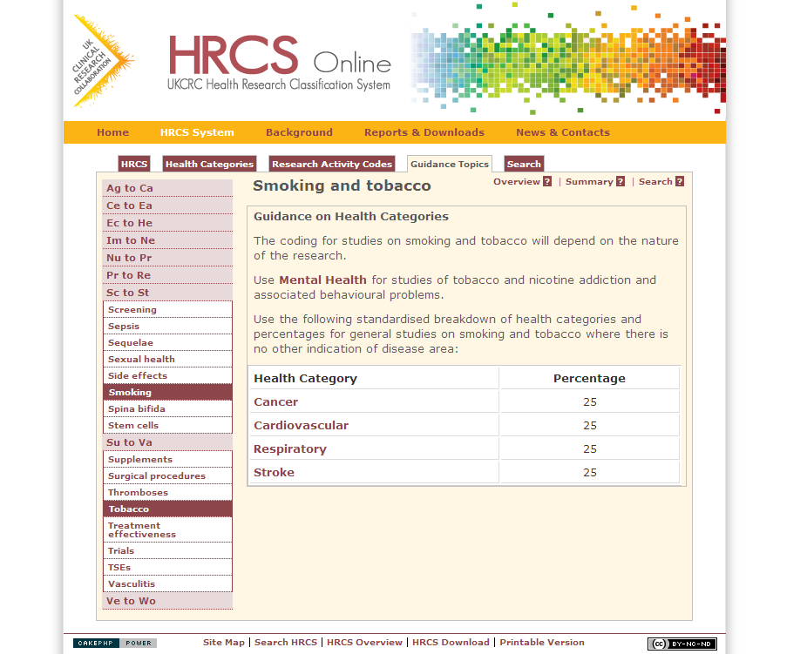
Guidance Topics on Health Categories
See specific guidance on:
Sequelae
When a condition is a consequence or side effect of a pre-existing condition
If double coding, does one code make sense without the other?
Multiple diseases and conditions
Health category list for use in four areas – Alcohol; Diet / nutrition; Physical activity / exercise; Tobacco / smoking
Use only in the absence of other information
Notes:
Finally there are two important quidance topics on the HRCS Online website which are important to be aware of when coding using Health Categories
Usually for a single research aim a single Health Category is applied to cover the particular condition being studied
However if one condition is a side effect or consequence of another (a sequela) it may be appropriate to apply two codes
An example might be a study of depression as a result of cancer, which would be coded using the Cancer and Mental Health categories
The usual rule of thumb is to consider if the study makes sense being classified with other studies coded with a single code – if not, then two catgeories might be applied
Another guidance topic relates to 4 areas of general study where there are multiple diseases and conditions
The topic defines lists of health categories to apply to studies in 4 areas: namely Alcohol, Diet / Nutrition, Physical Activity / Exercise and Tobacco / Smoking
The guidance topics in these areas can be looked up on the HRCS Online website but for example smoking involves applying the following 4 codes: Cancer, Cardiovascular, Respiratory, Stroke
Note these code combinations are only applied in the cases where the is no other indication of the codes to apply – for example if a study was specifically focussed on addiction behaviours in the context of smoking, this guidance would not apply and the research would be classified under Mental Health

Slide 36
Overview of Research Activity Code Groups
1 | Underpinning Research | Research that underpins investigations into the cause, development, detection, treatment and management of diseases, conditions and ill health
2 | Aetiology | Identification of determinants that are involved in the cause, risk or development of disease, conditions and ill health
3 | Prevention of Disease and Conditions, and Promotion of Well-Being | Research aimed at the primary prevention of disease, conditions or ill health, or promotion of well-being
4 | Detection, Screening and Diagnosis | Discovery, development and evaluation of diagnostic, prognostic and predictive markers and technologies
5 | Development of Treatments and Therapeutic Interventions | Discovery and development of therapeutic interventions and testing in model systems and preclinical settings
6 | Evaluation of Treatments and Therapeutic Interventions | Testing and evaluation of therapeutic interventions in clinical, community or applied settings
7 | Management of Diseases and Conditions | Research into individual care needs and management of disease, conditions or ill health
8 | Health and Social Care Services Research | Research into the provision and delivery of health and social care services, health policy and studies of research design, measurements and methodologies
Notes:
This table is an overview of the HRCS Research Activity Code groups
There are 48 codes each of which falls into one of these 8 groups as described.
Full details on all the codes are available in the HRCS booklet and on the HRCS Online website
In the next few slides I will review some key points about the 8 groups of Research Activity Codes

Slide 37
Notes on Research Activity Codes (1)
1 Underpinning
normal / healthy / non-diseased
pain, immune responses, pregnancy, ageing, cell death DNA repair are considered normal
not just biological = chemistry, psychology, social
2 Aetiology
not just causation – describing development, progression and life course of disease
includes epidemiology and observational studies
Notes:
The first code group is called Underpinning and is different from the other 7 groups because it covers all studies of normal healthy non-diseased processes.
Note this means that if a study is given a Health Category of Cancer or Infection it is unlikely to also be classified in Underpinning
However also note that pain, immune responses, pregnancy, ageing, cell death and DNA repair are all considered normal processes so studies in those areas can go here
Additionally note that normal is not just biologically normal – the group also includes studies in the area of socioeconomics, psychology and in the chemical and physical sciences
The second code group is called Aetiology but note the group is different from the dictionary definition of the word aetiology (which is about causation). It covers all research investigating the development progression and life course of a disease
In particular observational and epidemiological studies and cohort studies belong here. It includes all studies investigating incidence and prevalence of disease.

Slide 38
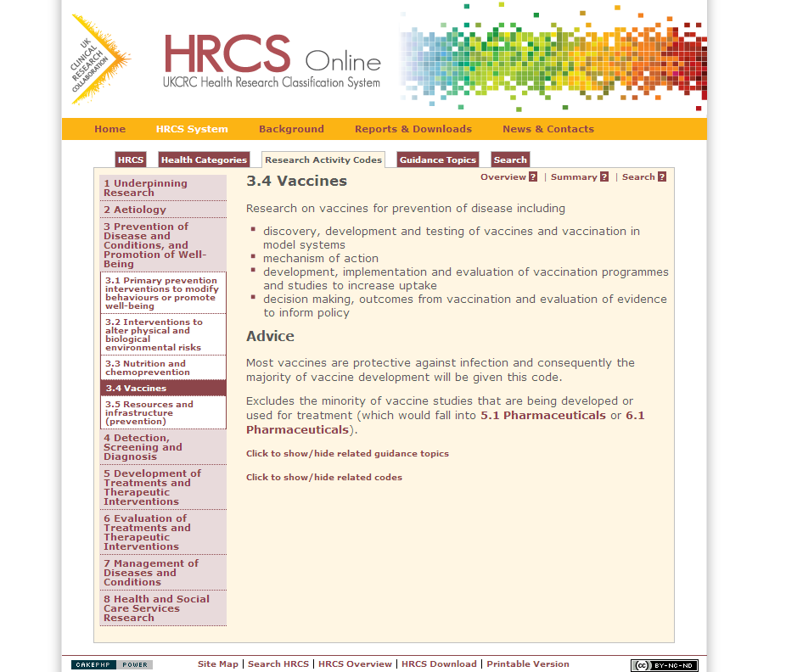
Notes on Research Activity Codes (2)
3 Prevention
excludes secondary prevention (prevention of a condition recurring)
4 Detection and Diagnosis
markers / screening / monitoring / prediction
4.1 – pre-clinical / lab based
4.2 – clinical studies in humans
5 Treatment Development
pre-clinical / lab based - including patient samples
Notes:
The third code group is Prevention which is about primary prevention. It focusses on studies reducing future risk in healthy people
Vaccine studies and behavioral change programmes belong in here
Note that the Prevention group does not include secondary prevention. This is where a previous condition is prevented from recurring – secondary prevention should be coded in one of the treatment groups (see later)
The fourth group is called Detection and Diagnosis. It includes all studies which monitor and predict the future course of a condition
It includes studies of screening and two codes for studies looking for predictive markers
Note that the 4.1 code covers pre-clinical lab based studies of markers, whereas 4.2 applies to clinical studies of markers in humans.
There is a similar clinical/pre-clinical split between two main code groups which cover treatment and therapies.
The fifth group is called Treatment Development which applies to pre-clinical laboratory based studies of therapies and treatments

Slide 39
Notes on Research Activity Codes (3)
6 Treatment Evaluation
clinical studies in humans – including all therapeutic trials phases I-IV
includes economic evaluation and assessing quality of life as part of study measures
7 Disease Management
personal perspective – research into activities of health professionals and/or needs of patients
8 Health Services
institutional perspective – research into organisations and service delivery
Notes:
Whereas the sixth group is Treatment Evaluation which includes all fully clinical studies of therapies on human subjects.
In particular this group includes all therapeutic clinical trials (phases I-IV) – however it excludes laboratory studies on patient samples which belong in group 5 Treatment Development
Also note that both treatment groups (5 and 6) cover not just pharmaceuticals, but also physical therapies, surgical., medical devices, radiotherapy, gene therapies and so on
The seventh group is called Disease Management and it covers research into the needs of individual people in the context of overall disease management – it includes studies of patient needs, including end of life care, but also studies of health professionals (doctors and nurses) and improvements in their practice and procedures
The eight group is called Health Services. It is also about management of disease, but from an organisational perspective
It includes research into health care institutions, and the delivery and economics of health services
One point to note in the context of groups 7 and 8 is that many clinical therapeutic trials will include a component that assesses quality of life for the patients and an evaluation of economic effectiveness
However, if the main focus of the study is the therapy, they should not be coded in 7 or 8 – it is only studies whose main focus is economics or quality of life that should end up there

Slide 40
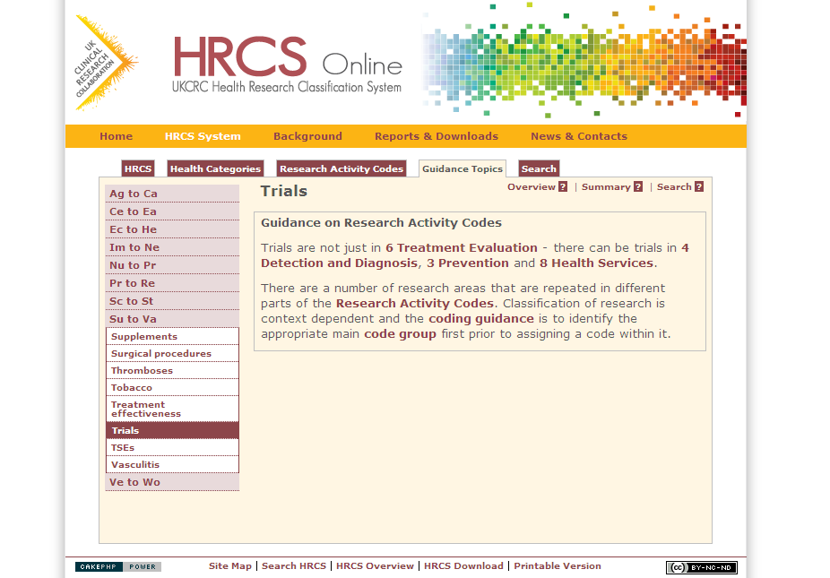
Guidance Topics on Research Activity Codes
See specific guidance on:
Repeated terms and concepts
Trials, policy, education, evaluation etc.
Methodology
Appears in 3 Groups
Resources and infrastructure
Appears in all 8 Groups
Notes:
There are some quidance topics on the HRCS Online website which it is important to be aware of when coding using Research Activity Codes
Firstly note that certain terms and concepts such as policy, trials, education, evaluation are repeated across the system and you cannot apply the right codes by searching for these words in the system. It is important to work out the appropriate top level code group before applying codes (as we shall see in the next few slides)
Secondly there are three places in the system for methodological studies – for further details see the HRCS Online website
Thirdly the HRCS system is mainly oriented around coding research activity but there is also a home in the system for major resources which are used by health researchers – each of the 8 code groups has a resources and infrastructure code to cover items such as cell lines, informatics systems or DNA banks

Slide 41
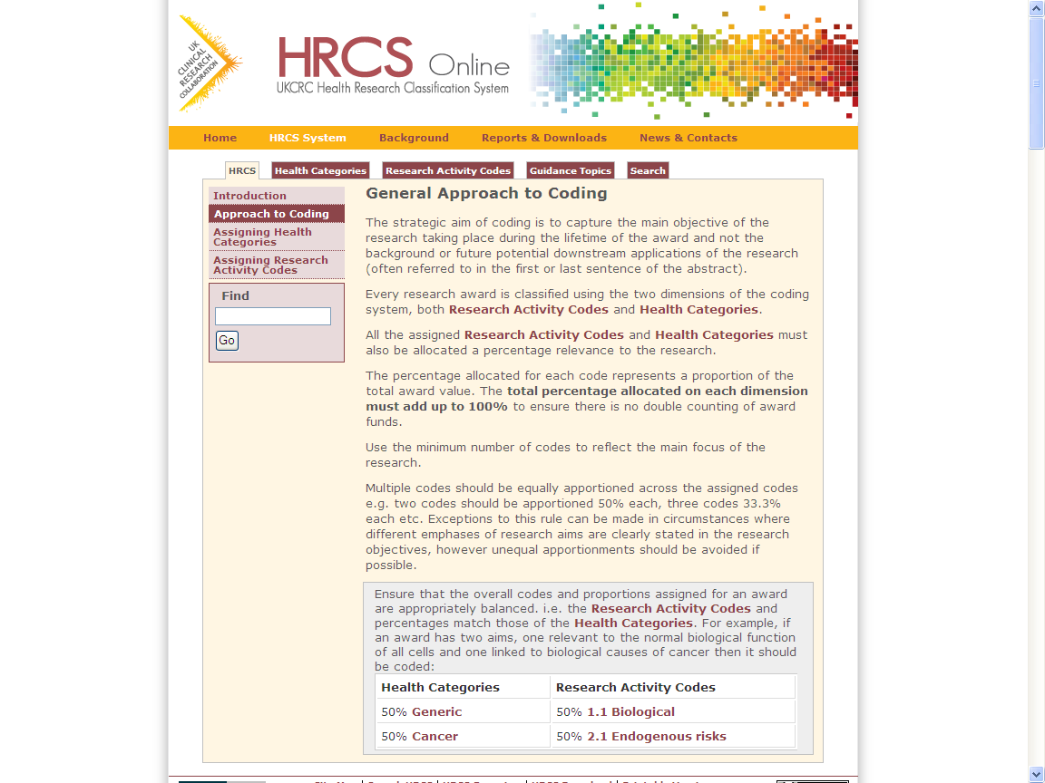
Approach to Coding
Identify main aim(s) and health focus(es) of research within lifetime of award
Allocate the minimum number of codes to reflect these
Assign equal percentages adding to 100% for both Health Categories and Research Activity Codes (unless there are clear reasons not to)
Example coding of one hypothetical award:
A clinical trial in humans to test a new drug therapy for treating lung cancer
6.1 Pharmaceuticals -> 100%
Cancer -> 100%
Notes:
This slide is a summary outline of the overall process for HRCS coding which will help you assign both Health Categories and Research Activity Codes successfully
Firstly always start by identifying the main aim or focus of the research within the period of the associated financial support
Secondly allocate the minimum number of codes to reflect these aims
Note that if there is more than one code then they should be given a percentage share adding to 100% – by default you should assign equal percentages, but unequal percentages can be assigned if there is a clear rationale for this in the abstract
Consider a simple example where it is decided that the main aim of an award is to fund a clinical trial in humans testing a new drug treatment for lung cancer
Once this summary is defined, the codes can be assigned
In this case the award would be coded as 100% code 6.1 Pharmaceuticals on the Research Activity Codes dimension
It would also be coded as 100% Cancer on the Health Categories dimension
In the following slides I provide further details on the process to assign each of these codes

Slide 42
Rules For Assigning Health Categories
Identify the main health or disease focus(es) of the award
Ignore background work often listed as being relevant and future potential downstream outcomes
Match each to a Health Category obeying the specific inclusion criteria
e.g. “testing a treatment for lung cancer” -> Cancer not Respiratory
Knowledge of pathogenesis, symptoms and disease site may not always be relevant
Assign up to a maximum of 5 Health Categories
Generic Health Relevance should be assigned if more than 5 categories apply or there is wide health relevance
The Other category is only for very specific cases – do not use if you are uncertain
Special rules
studies of alcohol, diet, exercise and smoking
consequences or side effects of a pre-existing condition
Notes:
When assigning the Health Categories you should start by reviewing the main health focus or focuses of the award
Note as indicated before it is important to ensure that you ignore any work which took place before this point and any future work which would be outside the scope of the current project
Match each of the identified health aims to a Health Category, obeying the inclusion criteria
In the example, we know that the study is into lung cancer but the Cancer category is not differentiated by site of action, so the code assigned is Cancer but not Respiratory
This emphasises the point made earlier that knowledge of pathogenesis and site of action may not always be relevant when coding
You can assign up to a max of 5 Health Categories – if more are required, apply the Generic category but never use the Other category in cases where you are uncertain or there is wide health relevance
Remember to also consider applying the specific guidance I gave you earlier regarding studies of alcohol, diet, exercise and smoking
Also remember the guidance about sequelae – this helps to decide if two or more codes are appropriate or just one.

Slide 43
Rules For Assigning Research Activity Codes
Identify the main aim(s) of the award
Ignore background work often listed as being relevant and future potential downstream outcomes
Match each to a Research Activity Code group
e.g. “a trial in humans testing a new therapy” -> 6 Treatment Evaluation
Note that HRCS code names and research concepts are repeated across code groups
e.g. trials are not always therapeutic trials
e.g. studies of therapies can be in humans or pre-clinical
Then select appropriate code from within group
e.g. “it is a drug trial” -> 6.1 Pharmaceuticals
Assign up to 2 Research Activity Codes (4 for large programmes)
Notes:
When coding using the Research Activity Codes you should also start by reviewing the main aim or aims of the award
In particular ensure that you have ignored any work which took place before this point and any future work which would be outside the scope of the current project
Always start by identifying the code group for each aim before you try to assign the detailed codes
Using the example, we know that is a trial in humans testing a new therapy, this summary places it in group 6 Treatment Evaluation
This coding decision should take into account the previous advice that concepts such as “trials” and “therapies” are repeated across the system – so there can be diagnostic trials, preventive trails and trials of health services in addition studies of therapy can be pre-clinical or clinical
So to assign it to group 6 we need the additional information that it is a trial but specifically that it is a trial in humans of a therapy
Once we have selected the code group (6) then we can use the additional information that this is a drugs trial to select the final code of 6.1 Pharamaceuticals
Note you can also assign multiple research activity codes to reflect multiple aims but the usual rule is to assign a maximum of two, with up to 4 available for a large programme of work

Slide 44
www.hrcsonline.net
james.carter@headoffice.mrc.ac.uk
Notes:
That concludes my presentation
Further detail is available from the HRCS website – HRCS Online – at the indicated web address
To get you started from this point you should start coding some simple example abstracts
I also recommend a very useful document for beginners available from the website in PDF form
It is called Common Mistakes and it lists 9 mistakes often made by those first using the HRCS system
Link to document: http://www.hrcsonline.net/sites/default/files/HRCS_Common_Mistakes.pdf

