Slide 1
Health Research Classification System
Understanding the System
(Advanced Coders)
Notes:
That completes my overview of the HRCS in terms of its origins and the uses it has been put to for the strategic analysis of health research in the UK.
In the second half of this talk I am going to review the purpose and structure of the HRCS and then cover how to use the system in practice

Slide 2
What is the HRCS?
A system for classifying and analysing health and biomedical research funding
Designed collaboratively by a range of funders for the following purposes:
To cover the full spectrum of all types of research across all areas of health and disease
To provide a single stable common system allowing meaningful comparisons across time and between different portfolios
To answer strategic questions about investment
To give a “broad brush” overview of funding patterns
Notes:
The HRCS was designed collaboratively by it’s the original research funders to summarise the full range of their common interests in health research
This means that by design it has a wide coverage to allow for comparisons across a range of organisations and settings
Another key aspect is its stability over time – to ensure that any comparisons are meaningful
Fundamentally it has a particular purpose at the strategic and national level where it gives a readily assimilable summary overview of the funding directly associated with particular health research activity
However you should note that the system is not intended to answer all possible questions about health research funding

Slide 3
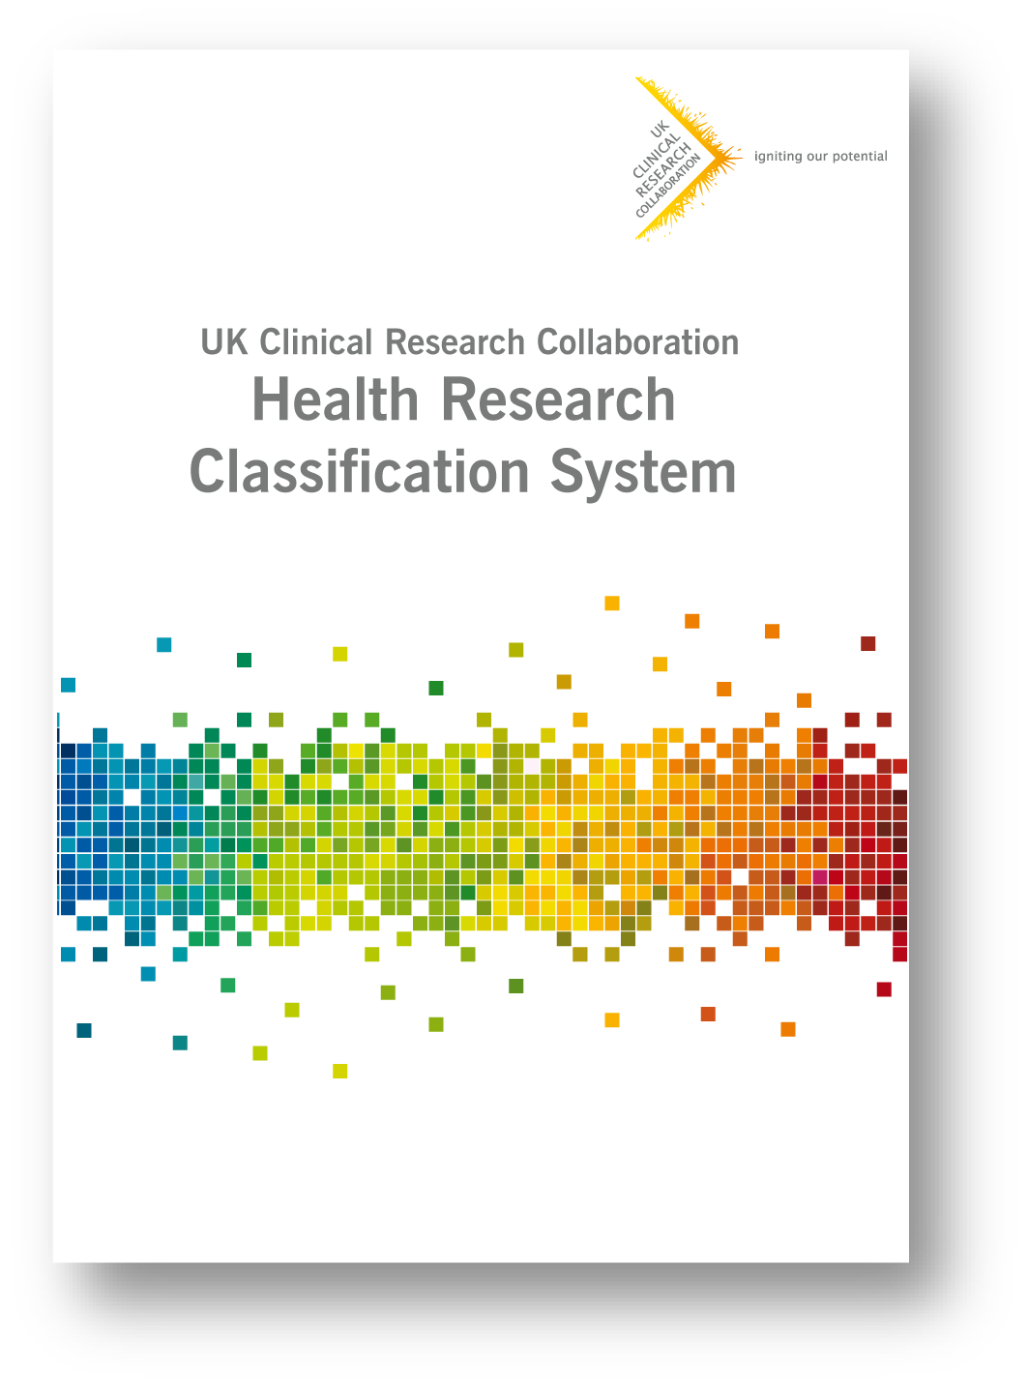
Structure of the HRCS
Two dimensional system
Health Categories
All areas of health or disease
21 individual categories
Based on WHO International Classification of Diseases
Research Activity Codes
All types of research activity from basic to applied
8 groups with 48 codes in X.X format
Based on cancer Common Scientific Outline
Notes:
During the rest of this presentation it will help if you have copy of the HRCS system definition booklet (pictured) to refer to
As indicated previously the HRCS has 2 coding dimensions and each award is coded using both dimensions
In the first dimension there are 21 Health Categories covering all areas of health and disease
The Health Categories are based on the well known World Health Organisation ICD codes
The other dimension of the system is the Research Activity Codes which cover all types of research activity from basic to applied
As we saw in the first half of the presentation there are 8 main Research Activity Code groups but these are based on 48 underlying individual codes which are assigned to an award when coding
And as seen previously the Research Activity Codes are based on the international cancer classification system known as the Common Scientific Outline or CSO
Link to HRCS booklet: http://www.hrcsonline.net/sites/default/files/HRCS_Document.pdf

Slide 4
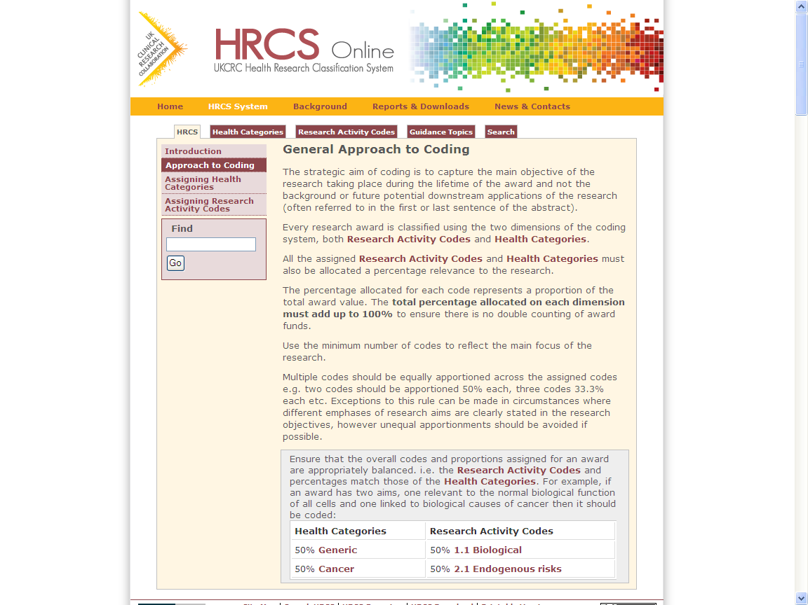
Approach to Coding
Identify main aim(s) and health focus(es) of research within lifetime of award
Be wary of keywords or terms
Allocate the minimum number of codes to reflect these
1-5 Health Categories
1-2 (max. 4) Research Activities
Assign equal percentages adding to 100% for both Health Categories and Research Activity Codes
Analyses use this to assign equal spend weighting
Remember HRCS context = landscaping tool
Used only to identify main research focus i.e. not auditing
Complements other systems for additional granularity
Notes:
This slide is a summary outline of the overall process for HRCS coding which will help you assign both Health Categories and Research Activity Codes successfully
Firstly always start by identifying the main aim or focus of the research within the period of the associated financial support
Secondly allocate the minimum number of codes to reflect these aims
You have a maximum allocation of 5 Health Categories, if 6+ use Generic
Guidance on Research Activity states use a maximum of two codes, up to four only for large programmes of research.
We are amending this view slightly in view of feedback regarding many trials that compare more than two treatments
In these situations, use 1-4 only if the award makes it explicitly clear
If a programme has many diverse aims, used a ‘resource and infrastructure’ code
Note that if there is more than one code then they should be given a percentage share adding to 100% – by default you should assign equal percentages, but unequal percentages can be assigned if there is a clear rationale for this in the abstract
Consider a simple example where it is decided that the main aim of an award is to fund a clinical trial in humans testing a new drug treatment for lung cancer
Once this summary is defined, the codes can be assigned
In this case the award would be coded as 100% code 6.1 Pharmaceuticals on the Research Activity Codes dimension
It would also be coded as 100% Cancer on the Health Categories dimension
In the following slides I provide further details on the process to assign each of these codes

Slide 5
HRCS Online website
Makes all existing information and resources accessible
Overarching aim to promote sustainability of the system
Guidance for naïve users wanting to learn how to use the system
Reference source for experienced users
Provides further contextual help, summaries and linkages
www.hrcsonline.net
Notes:
Another key aspect of the HRCS is the associated HRCS Online website (www.hrcsonline.net) set up to:
sustain the system in the long term
to promote it to different audiences e.g. internationally
hold all relevant HRCS information
provide both guidance for new users
act as a reference source for experienced users
There is contextual help and linkage throughout – for example if you want to explore the origins of the system:
each Health Category is linked to the relevant WHO ICD code
each Research Activity Code to the appropriate code in the Common Scientific Outline

Slide 6
Health Categories

Slide 7
Health Categories
Blood
Cancer
Cardiovascular
Congenital Disorders
Ear
Eye
Infection
Inflammatory and Immune System
Injuries and Accidents
Mental Health
Metabolic and Endocrine
Musculoskeletal
Neurological
Oral and Gastrointestinal
Renal and Urogenital
Reproductive Health and Childbirth
Respiratory
Skin
Stroke
Generic Health Relevance
Other
Note: Each category includes normal/healthy and disease processes
Note: Categories are not always deducible from causation, symptoms, or site of action
Notes:
This slide is a list of the HRCS Health Categories
There are 21 categories of which 19 are specific to particular health areas
Full details on all the categories are available in the HRCS definition booklet and on the HRCS Online website
However in the next few slides I will review some key points to note about particular health categories from this list
General Advice on Coding:
Health Categories should not be assigned to reflect mechanisms of pathogenesis or the site of a disease (e.g. Cancer and Infection).
Choose the Health Category associated with the purpose of the investigation or the overarching main disease.
Many diseases and conditions share characteristics of more than one area of health
(e.g. asthma is a respiratory disease and is also an autoimmune disease, so coded 100% Respiratory, not I&I)
And/or research may focus on a particular organ affected by a disease
(e.g. pulmonary hypertension, coded as 100% Cardiovascular, not respiratory).
However to ensure accurate and consistent coding it is important to follow the specific inclusion criteria listed in the Health Categories.

Slide 8
Notes on Health Categories (1)
Blood
Haematology, clotting, platelets/erythrocytes
Exclude diseases of the vasculature (Cardio)
Cancer
all types - not coded by site e.g. lung cancer
Includes neoplasms and non-malignant
Studies of oncogenes/TSGs = 50% Generic, 50% 1.1/2.1
Studies of predisposition = 50% X
Studies of carcinogenic pathogens = 50% Infection
Rarely coded to RA1 Underpinning
Cardiovascular
Normal development and diseases of vasculature / lymphatic / cardiovascular system
includes atherosclerosis, CHD, PHT and congenital heart disorders
Exclude blow flow to brain (Stroke) and anti-angiogenic drugs targeting tumour growth (Cancer)
Notes:
The Cancer category covers all type of cancer – they are not differentiated by site of action – studies of lung cancer are coded as Cancer and the respiratory aspect is not captured
The Cardiovascular category is not just studies of the heart, it includes atherosclerosis and other disorders of blood circulation
The Congenital Disorders code covers inherited disorders with multiple types of disease and condition such as cystic fibrosis – it excludes inherited disorders with a single focus, such as congenital heart disorders
The Infection category applies to all types of infection – like the Cancer code, infections are not differentiated by site of action
The Inflammatory and Immune code is designed for studies of the immune system – it should not be applied simply because a disorder has an immune response component, which will be the case in many conditions
The Mental Health code includes all abnormal conditions defined by behaviour but also normal behavioural and cognitive function

Slide 9
Notes on Health Categories (2)
Congenital Disorders
multiple syndromes - excludes single focus syndromes like congenital heart disorders, cleft palate etc.
Includes Down Syndrome, Cystic Fibrosis
Infection
all pathogens/types - not coded by site
e.g. respiratory tract infections not Respiratory
E.g. malarial parasite not Blood
General sexual health (no agent) = 50% Reproduction
Carcinogenic pathogens = 50% Cancer
Sepsis = 50% Inflammatory
Excludes natural tolerance/immunity (100% Inflammatory)
Excludes prions / BSE / CJD (100% Neurological)
Notes:
The Cancer category covers all type of cancer – they are not differentiated by site of action – studies of lung cancer are coded as Cancer and the respiratory aspect is not captured
The Cardiovascular category is not just studies of the heart, it includes atherosclerosis and other disorders of blood circulation
The Congenital Disorders code covers inherited disorders with multiple types of disease and condition such as cystic fibrosis – it excludes inherited disorders with a single focus, such as congenital heart disorders
The Infection category applies to all types of infection – like the Cancer code, infections are not differentiated by site of action
The Inflammatory and Immune code is designed for studies of the immune system – it should not be applied simply because a disorder has an immune response component, which will be the case in many conditions
The Mental Health code includes all abnormal conditions defined by behaviour but also normal behavioural and cognitive function

Slide 10
Notes on Health Categories (3)
Ear / Eye
Involvement of auditory/optic nerve = 50% Neurological
Brain mapping for hearing/sight = 100% Neurological
Inflammatory and Immune System
Normal function and diseases of the immune system (not just immune response)
Includes rheumatoid arthritis, autoimmune, allergies
Sepsis = 50% Infection
Asthma = normally respiratory, but if in relation to allergies use 50%
Atherosclerosis = 100% Cardiovascular
Injuries and Accidents
External only – fractures, burns, poison – ignore for internal damage/repair e.g. ischemia
Wound healing only if acquired by accident
Notes:
The Cancer category covers all type of cancer – they are not differentiated by site of action – studies of lung cancer are coded as Cancer and the respiratory aspect is not captured
The Cardiovascular category is not just studies of the heart, it includes atherosclerosis and other disorders of blood circulation
The Congenital Disorders code covers inherited disorders with multiple types of disease and condition such as cystic fibrosis – it excludes inherited disorders with a single focus, such as congenital heart disorders
The Infection category applies to all types of infection – like the Cancer code, infections are not differentiated by site of action
The Inflammatory and Immune code is designed for studies of the immune system – it should not be applied simply because a disorder has an immune response component, which will be the case in many conditions
The Mental Health code includes all abnormal conditions defined by behaviour but also normal behavioural and cognitive function

Slide 11
Notes on Health Categories (4)
Mental Health
includes normal behavioural and cognitive function and all abnormal conditions defined by behavior – distinct from Neurological
Depression, schizophrenia, psychosis and personality disorders, addiction, suicide, anxiety, eating disorders, learning disabilities, autistic spectrum disorders and studies of normal psychology, cognitive function and behavior
Any studies coded exclusively to 1.2 Psychological / Socioeconomic
Neurological
Brain function / ‘wiring’ – distinct from Mental Health
Includes neurodegenerative conditions: Dementias, Parkinson's, Alzheimer's.
Also includes TSEs, epilepsy, multiple sclerosis prions/BSE/CJD and studies of the normal brain and nervous system
Can include studies of circadian rhythm, headaches/migraines (usually, not exclusively)
Exclude studies of the brain with psychological conditions listed in Mental Health
Examples of dual coding (N/MH)
Mapping of brain structure (should also be 1.1 Biological and 1.2 Psychological)
Notes:
The Cancer category covers all type of cancer – they are not differentiated by site of action – studies of lung cancer are coded as Cancer and the respiratory aspect is not captured
The Cardiovascular category is not just studies of the heart, it includes atherosclerosis and other disorders of blood circulation
The Congenital Disorders code covers inherited disorders with multiple types of disease and condition such as cystic fibrosis – it excludes inherited disorders with a single focus, such as congenital heart disorders
The Infection category applies to all types of infection – like the Cancer code, infections are not differentiated by site of action
The Inflammatory and Immune code is designed for studies of the immune system – it should not be applied simply because a disorder has an immune response component, which will be the case in many conditions
The Mental Health code includes all abnormal conditions defined by behaviour but also normal behavioural and cognitive function

Slide 12
Notes on Health Categories (5)
Metabolic & Endocrine
Studies of normal / disease of metabolism, hormones
Include Diabetes, thyroid disease, metabolic disorders
Exclude generic signaling pathways/kinases studies
Exclude reproductive hormones
Musculoskeletal
Normal / diseases of bone / muscle / cartilage
Osteoarthritis, Osteoporosis, muscular dystrophies
Oral & Gastrointestinal
Covers dentition, mouth, oesophagus, digestive system, liver, pancreas (excluding insulin – metabolic).
Includes IBD, Crohn’s and issues of gut absorption
Notes:
The Musculoskeletal code includes osteoarthritis but not rheumatoid arthritis which belongs in the Inflammatory and Immune category
The Neurological code includes studies of brain function and brain interconnections – it includes the dementias and also BSE = Bovine Spongiform Encephalopathy
The Reproduction category includes research into all aspects of pregnancy, birth and the newborn
The Respiratory category is about lung function and includes studies of asthma

Slide 13
Notes on Health Categories (6)
Renal & Urogenital
Normal / diseases of kidney, pelvic inflammation, genitalia
Studies of sexual organs not linked to reproduction
Reproductive Health and Childbirth
includes all aspects of pregnancy, ante-/post-natal and the new born (~M12)
Includes studies of exposure / in utereo for foetus / newborn, BUT excludes studies in children/adults
PND/PPD = usually 50% Mental Health
General sexual health = 50% Infection
Respiratory
Normal / diseases of respiratory system including asthma, COPD
Exclude Pulmonary Hypertension (Cardio) & RTIs (Infection)
Air Pollution = 50% Generic
Notes:
The Musculoskeletal code includes osteoarthritis but not rheumatoid arthritis which belongs in the Inflammatory and Immune category
The Neurological code includes studies of brain function and brain interconnections – it includes the dementias and also BSE = Bovine Spongiform Encephalopathy
The Reproduction category includes research into all aspects of pregnancy, birth and the newborn
The Respiratory category is about lung function and includes studies of asthma

Slide 14
Notes on Health Categories (3)
Skin
Dermatological conditions inc. ulcers
Stroke
Ischemic and haemorrhagic, blood flow to the brain and post-stroke conditions e.g. dysarthria
Generic Health Relevance
all areas of health or general health / wellbeing
No particular disease / normal function of cell type / system
Or >5 Health Categories
Other (“Disputed Aetiology & Other”)
A few very specific areas – not a dustbin
Disputed Aetiology: including Gulf War syndrome and chronic fatigue syndrome
Studies of animal welfare (w/ relevance to health)
Social studies of ‘at risk’ populations (w/ relevance to health)
Notes:
Finally there are two health categories which are not specific to a particular health area
The Generic Health Relevance category is applied if research is relevant to all areas of health or to health in general
It should also be applied if the research is found to be relevant to more than 5 Health Categories
The Other category has a specific purpose and should never be used as a dustbin category – ie when you are not certain which code to apply
It should only be used in a few very specific circumstances where no other code will do
In the UK it has been used for studies of Gulf war syndrome and chronic fatigue syndrome where there is controversy about the nature of the disorder
In general there are 2 important points to note about the Health Categories:
1. Apart from Cancer and Infection, Health Categories include studies of both normal healthy function as well as disease processes
2. The appropriate categories cannot always be deduced from knowledge of causation, symptoms or site of action

Slide 15
Guidance Topics on Health Categories
Sequelae
When a condition is a consequence or side effect of a pre-existing condition
If double coding, does one code make sense without the other?
E.g. Diabetic Ulcers, Post-natal Depression
Multiple diseases and conditions
Health category list for use in four areas – Alcohol; Diet / nutrition; Physical activity / exercise; Tobacco / smoking
Use only in the absence of other information
SEE WEBSITE FOR MORE
Notes:
Finally there are two important quidance topics on the HRCS Online website which are important to be aware of when coding using Health Categories
Usually for a single research aim a single Health Category is applied to cover the particular condition being studied
However if one condition is a side effect or consequence of another (a sequela) it may be appropriate to apply two codes
An example might be a study of depression as a result of cancer, which would be coded using the Cancer and Mental Health categories
The usual rule of thumb is to consider if the study makes sense being classified with other studies coded with a single code – if not, then two catgeories might be applied
Another guidance topic relates to 4 areas of general study where there are multiple diseases and conditions
The topic defines lists of health categories to apply to studies in 4 areas: namely Alcohol, Diet / Nutrition, Physical Activity / Exercise and Tobacco / Smoking
The guidance topics in these areas can be looked up on the HRCS Online website but for example smoking involves applying the following 4 codes: Cancer, Cardiovascular, Respiratory, Stroke
Note these code combinations are only applied in the cases where the is no other indication of the codes to apply – for example if a study was specifically focussed on addiction behaviours in the context of smoking, this guidance would not apply and the research would be classified under Mental Health

Slide 16
Research Activities

Slide 17
Overview of Research Activity Code Groups
1 | Underpinning Research | Research that underpins investigations into the cause, development, detection, treatment and management of diseases, conditions and ill health
2 | Aetiology | Identification of determinants that are involved in the cause, risk or development of disease, conditions and ill health
3 | Prevention of Disease and Conditions, and Promotion of Well-Being | Research aimed at the primary prevention of disease, conditions or ill health, or promotion of well-being
4 | Detection, Screening and Diagnosis | Discovery, development and evaluation of diagnostic, prognostic and predictive markers and technologies
5 | Development of Treatments and Therapeutic Interventions | Discovery and development of therapeutic interventions and testing in model systems and preclinical settings
6 | Evaluation of Treatments and Therapeutic Interventions | Testing and evaluation of therapeutic interventions in clinical, community or applied settings
7 | Management of Diseases and Conditions | Research into individual care needs and management of disease, conditions or ill health
8 | Health and Social Care Services Research | Research into the provision and delivery of health and social care services, health policy and studies of research design, measurements and methodologies
Notes:
REMINDER
1-2 (Max 4) Research Activities per award
Guidance on Research Activity states use a maximum of two codes, up to four only for large programmes of research.
We are amending this view slightly in view of feedback regarding many trials that compare more than two treatments
In these situations, use 1-4 only if the award makes it explicitly clear
If a programme has many diverse aims, used a ‘resource and infrastructure’ code
This table is an overview of the HRCS Research Activity Code groups
There are 48 codes each of which falls into one of these 8 groups as described.
Full details on all the codes are available in the HRCS booklet and on the HRCS Online website
In the next few slides I will review some key points about the 8 groups of Research Activity Codes

Slide 18
RA1: Underpinning
Research that underpins investigations into the cause, development, detection, treatment and management of diseases, conditions and ill health
Includes: studies of normal / healthy / non-diseased processes
pain, immune responses, pregnancy, ageing, cell cycle, cell death and DNA repair are all considered normal
Basic mechanisms of wound healing and stem cell differentiation can be Underpinning, but dependent on context – see Exclusions
Bioinformatics and structural studies often Underpinning, but dependent on context
Development/characterization of model systems
Not just biological; includes social, behavioural and environmental
Excludes: research where main aim relates to cause, development, prevention, detection, treatment or management
Note: majority of Cancer and Infection studies not Underpinning
E.g. abnormal function of cell cycle / DNA repair
Normal role of oncogenes / TSGs in non-diseased cell = 50% 1.1/2.1
Infectious agents of disease are never Underpinning, but studies of yeast / bacteria as model systems can be.
Notes:
The first code group is called Underpinning and is different from the other 7 groups because it covers all studies of normal healthy non-diseased processes.
Note this means that if a study is given a Health Category of Cancer or Infection it is unlikely to also be classified in Underpinning
However also note that pain, immune responses, pregnancy, ageing, cell death and DNA repair are all considered normal processes so studies in those areas can go here
Additionally note that normal is not just biologically normal – the group also includes studies in the area of socioeconomics, psychology and in the chemical and physical sciences
The second code group is called Aetiology but note the group is different from the dictionary definition of the word aetiology (which is about causation). It covers all research investigating the development progression and life course of a disease
In particular observational and epidemiological studies and cohort studies belong here. It includes all studies investigating incidence and prevalence of disease.

Slide 19
RA1: Underpinning (cont.)
1.1 – Normal biological development and functioning
Studies of normal biological function not linked to disease e.g. genes/gene products, molecular/physiological/pathway structure/function, bioinformatics
1.2 – Psychological and socioeconomic processes
Studies of perception, memory and cognition / learning processes
Includes social/cultural beliefs, individual/group characteristics/behaviours, political, economic and urban development, and psychological modelling
1.3 – Chemical and physical sciences
Chemical, physical and bioengineering research that underpins development of therapies and/or diagnostics
1.4 – Methodologies and measurements
Development of novel methods/measurements/research designs for use in underpinning research
Note: includes making methods/tools publically available (i.e. not 1.5)
1.5 – Resources and Infrastructure
Development and/or distribution of resources for use by the research community OR infrastructure / support for research networks, consortia and centres
Notes:
The first code group is called Underpinning and is different from the other 7 groups because it covers all studies of normal healthy non-diseased processes.
Note this means that if a study is given a Health Category of Cancer or Infection it is unlikely to also be classified in Underpinning
However also note that pain, immune responses, pregnancy, ageing, cell death and DNA repair are all considered normal processes so studies in those areas can go here
Additionally note that normal is not just biologically normal – the group also includes studies in the area of socioeconomics, psychology and in the chemical and physical sciences
The second code group is called Aetiology but note the group is different from the dictionary definition of the word aetiology (which is about causation). It covers all research investigating the development progression and life course of a disease
In particular observational and epidemiological studies and cohort studies belong here. It includes all studies investigating incidence and prevalence of disease.

Slide 20
RA2: Aetiology
Identification of determinants that are involved in the cause, risk or development of disease, conditions and ill health – i.e. the “mechanism of disease”
not just causation – describing development, progression and life course of disease
Includes:
epidemiology and observational studies
Basic research in Cancer and Infection (not underpinning)
Excludes:
studies of normal structure of function not linked to specific disease/condition stimuli (RA1)
mechanism of action of treatments e.g. pharmacogenetics (RA5)
Notes:
The third code group is Prevention which is about primary prevention. It focusses on studies reducing future risk in healthy people
Vaccine studies and behavioral change programmes belong in here
Note that the Prevention group does not include secondary prevention. This is where a previous condition is prevented from recurring – secondary prevention should be coded in one of the treatment groups (see later)
The fourth group is called Detection and Diagnosis. It includes all studies which monitor and predict the future course of a condition
It includes studies of screening and two codes for studies looking for predictive markers
Note that the 4.1 code covers pre-clinical lab based studies of markers, whereas 4.2 applies to clinical studies of markers in humans.
There is a similar clinical/pre-clinical split between two main code groups which cover treatment and therapies.
The fifth group is called Treatment Development which applies to pre-clinical laboratory based studies of therapies and treatments

Slide 21
RA2: Aetiology (cont.)
2.1 – Biological and endogenous
Biological causes of disease (e.g. genetic, physiological, infection response)
Note on Biomarkers: characterising pathways for candidates = 2.1, whereas marker discovery = 4.1
2.2 – Physical environment
Environmental or external factors with cause/risk/development of disease
E.g. pollution, radiation, chemical, or pathogens
Note: Studies of pathogens = 2.1 for host responses, 2.2 for pathogen life cycle
2.3 – Psychological, social and economic
Causes of psychological conditions or diseases with associated socioecomic factors e.g. behaviours/lifestyles, cultural/religious beliefs, ethnicity/age/gender
2.4 – Surveillance
Used for observational studies that are descriptive and do not involve characterising mechanisms (i.e. for studies with main aim to develop and monitor cohorts, not just use cohorts as part of a wider study)
2.5 – Methodology
Develop aetiological / epidemiological research designs, measures and methods (e.g. informatics studies involving genetic linkage to disease)
Notes:
The third code group is Prevention which is about primary prevention. It focusses on studies reducing future risk in healthy people
Vaccine studies and behavioral change programmes belong in here
Note that the Prevention group does not include secondary prevention. This is where a previous condition is prevented from recurring – secondary prevention should be coded in one of the treatment groups (see later)
The fourth group is called Detection and Diagnosis. It includes all studies which monitor and predict the future course of a condition
It includes studies of screening and two codes for studies looking for predictive markers
Note that the 4.1 code covers pre-clinical lab based studies of markers, whereas 4.2 applies to clinical studies of markers in humans.
There is a similar clinical/pre-clinical split between two main code groups which cover treatment and therapies.
The fifth group is called Treatment Development which applies to pre-clinical laboratory based studies of therapies and treatments

Slide 22
RA3: Prevention
Research aimed at the primary prevention of disease, conditions or ill health, or promotion of well-being
excludes secondary prevention (prevention of a condition recurring)
3.1 – Primary Prevention
Development, implementation and evaluation of interventions to modify personal or group behaviours and lifestyles affecting health and well-being
Exclude epidemiology assessing cause/incidence (RA2)
3.2 – Environment
Physical, biological and environmental risks
3.3 – Nutrition
Health protective (nutrients) and chemopreventative (oral contraception)
3.4 – Vaccines
All aspects of vaccine study, excluding use as therapeutics
Notes:
The third code group is Prevention which is about primary prevention. It focusses on studies reducing future risk in healthy people
Vaccine studies and behavioral change programmes belong in here
Note that the Prevention group does not include secondary prevention. This is where a previous condition is prevented from recurring – secondary prevention should be coded in one of the treatment groups (see later)
The fourth group is called Detection and Diagnosis. It includes all studies which monitor and predict the future course of a condition
It includes studies of screening and two codes for studies looking for predictive markers
Note that the 4.1 code covers pre-clinical lab based studies of markers, whereas 4.2 applies to clinical studies of markers in humans.
There is a similar clinical/pre-clinical split between two main code groups which cover treatment and therapies.
The fifth group is called Treatment Development which applies to pre-clinical laboratory based studies of therapies and treatments

Slide 23
RA4: Detection, Screening & Diagnosis
Discovery, development and evaluation of diagnostic, prognostic and predictive markers and technologies
Include research aimed to produce diagnostic/prognostic tests for clinical use
Exclude research using imaging/detection techniques if aim is not clinical tests
4.1 – Marker discovery
pre-clinical / lab based
4.2 – Marker evaluation
clinical studies in humans
4.3 – Influences
Studies investigating impact of screening and factors affecting uptake
4.4 – Screening
Population level (not individual), ≠ epidemiology
Notes:
The third code group is Prevention which is about primary prevention. It focusses on studies reducing future risk in healthy people
Vaccine studies and behavioral change programmes belong in here
Note that the Prevention group does not include secondary prevention. This is where a previous condition is prevented from recurring – secondary prevention should be coded in one of the treatment groups (see later)
The fourth group is called Detection and Diagnosis. It includes all studies which monitor and predict the future course of a condition
It includes studies of screening and two codes for studies looking for predictive markers
Note that the 4.1 code covers pre-clinical lab based studies of markers, whereas 4.2 applies to clinical studies of markers in humans.
There is a similar clinical/pre-clinical split between two main code groups which cover treatment and therapies.
The fifth group is called Treatment Development which applies to pre-clinical laboratory based studies of therapies and treatments

Slide 24
RA5: Treatment Development
Discovery and development of therapeutic interventions and testing in model systems and preclinical settings
pre-clinical = lab based / not ‘whole’ human
i.e. in vitro, in vivo, patient samples
5.1 – Pharmaceutical
Includes pharmcogenetics, drug response and drug modelling
5.2 – Cellular & Gene Therapies
Includes stem cells, IVF, tissue engineering
Avoid dual coding cell transplantation as 5.4
5.3 – Devices
Implants, mobility aids, dressings, equipment and prostheses
5.4 – Surgery
Includes histocompatibility, tolerances, rejection
5.5 – Radiotherapy
Includes electromagnetic, ultrasound, laser and phototherapies
5.7 – Physical
Includes dietics but exclude supplements (5.1, or 3.3 if preventative)
Notes:
The third code group is Prevention which is about primary prevention. It focusses on studies reducing future risk in healthy people
Vaccine studies and behavioral change programmes belong in here
Note that the Prevention group does not include secondary prevention. This is where a previous condition is prevented from recurring – secondary prevention should be coded in one of the treatment groups (see later)
The fourth group is called Detection and Diagnosis. It includes all studies which monitor and predict the future course of a condition
It includes studies of screening and two codes for studies looking for predictive markers
Note that the 4.1 code covers pre-clinical lab based studies of markers, whereas 4.2 applies to clinical studies of markers in humans.
There is a similar clinical/pre-clinical split between two main code groups which cover treatment and therapies.
The fifth group is called Treatment Development which applies to pre-clinical laboratory based studies of therapies and treatments

Slide 25
RA6: Treatment Evaluation
Testing and evaluation of therapeutic interventions in clinical, community or applied settings
clinical studies in humans – including all therapeutic trials phases I-IV
includes economic evaluation and assessing quality of life as part of study measures
6.1 – Pharmaceuticals
Include pharmacokinetics, drug resistance and side effects
6.7 – Physical
Includes temperature / oxygen therapies, but excludes nutritional supplements
Notes:
The third code group is Prevention which is about primary prevention. It focusses on studies reducing future risk in healthy people
Vaccine studies and behavioral change programmes belong in here
Note that the Prevention group does not include secondary prevention. This is where a previous condition is prevented from recurring – secondary prevention should be coded in one of the treatment groups (see later)
The fourth group is called Detection and Diagnosis. It includes all studies which monitor and predict the future course of a condition
It includes studies of screening and two codes for studies looking for predictive markers
Note that the 4.1 code covers pre-clinical lab based studies of markers, whereas 4.2 applies to clinical studies of markers in humans.
There is a similar clinical/pre-clinical split between two main code groups which cover treatment and therapies.
The fifth group is called Treatment Development which applies to pre-clinical laboratory based studies of therapies and treatments

Slide 26
RA7: Disease Management
Management of diseases and conditions from an individual / personal (not institutional/organizational) perspective
i.e. research into activities of health professionals and/or needs of patients
7.1 Individual care needs
Studies of patients and carers management and the direct / indirect implications of their disease
E.g. management of symptoms, psychological/socioeconomic impact of ill health, compliance and attitudes to treatment, assessment of care needs, education or communication to improve health/self-care
7.2 End of life care
All aspects of palliative care
7.3 Management and decision making
Studies of health and social care professionals as individuals
E.g. factors influencing diagnosis/treatment, development of decision making guidelines/models, testing and evaluating management regimes
Notes:
Whereas the sixth group is Treatment Evaluation which includes all fully clinical studies of therapies on human subjects.
In particular this group includes all therapeutic clinical trials (phases I-IV) – however it excludes laboratory studies on patient samples which belong in group 5 Treatment Development
Also note that both treatment groups (5 and 6) cover not just pharmaceuticals, but also physical therapies, surgical., medical devices, radiotherapy, gene therapies and so on
The seventh group is called Disease Management and it covers research into the needs of individual people in the context of overall disease management – it includes studies of patient needs, including end of life care, but also studies of health professionals (doctors and nurses) and improvements in their practice and procedures
The eight group is called Health Services. It is also about management of disease, but from an organisational perspective
It includes research into health care institutions, and the delivery and economics of health services
One point to note in the context of groups 7 and 8 is that many clinical therapeutic trials will include a component that assesses quality of life for the patients and an evaluation of economic effectiveness
However, if the main focus of the study is the therapy, they should not be coded in 7 or 8 – it is only studies whose main focus is economics or quality of life that should end up there

Slide 27
RA8: Health Services
institutional perspective – research into organisation and delivery of health and social care services
8.1 – Organisation and service delivery
All aspects of health care service delivery, including service user experience
Also includes impact evaluation of non-specific/multiple treatments on given condition (e.g. interventions vs. prevalence of cardiovascular disease)
8.2 – Health and welfare economics
Use only where main aim is economic assessment
Note: many evaluations (prevention studies, diagnostic tools, therapeutic trials) include an economic component
8.3 – Policy, ethics and research governance
8.4 – Research design and methodology
Development of novel methodology, research design and measurements in treatment, management and health services research
Exclude models for disease management decision making (7.3) and economic models of health services (8.2)
Notes:
Whereas the sixth group is Treatment Evaluation which includes all fully clinical studies of therapies on human subjects.
In particular this group includes all therapeutic clinical trials (phases I-IV) – however it excludes laboratory studies on patient samples which belong in group 5 Treatment Development
Also note that both treatment groups (5 and 6) cover not just pharmaceuticals, but also physical therapies, surgical., medical devices, radiotherapy, gene therapies and so on
The seventh group is called Disease Management and it covers research into the needs of individual people in the context of overall disease management – it includes studies of patient needs, including end of life care, but also studies of health professionals (doctors and nurses) and improvements in their practice and procedures
The eight group is called Health Services. It is also about management of disease, but from an organisational perspective
It includes research into health care institutions, and the delivery and economics of health services
One point to note in the context of groups 7 and 8 is that many clinical therapeutic trials will include a component that assesses quality of life for the patients and an evaluation of economic effectiveness
However, if the main focus of the study is the therapy, they should not be coded in 7 or 8 – it is only studies whose main focus is economics or quality of life that should end up there

Slide 28
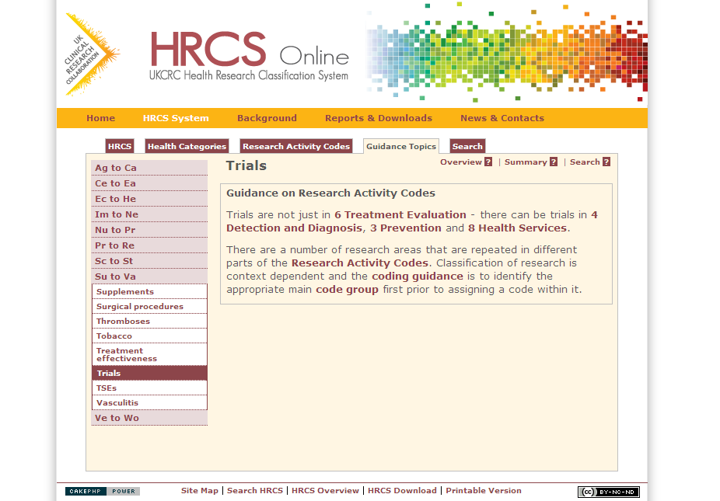
Guidance Topics on Research Activity Codes
See specific guidance on:
Repeated terms and concepts
Trials, policy, education, evaluation etc.
Methodology
Appears in 3 Groups
Resources and infrastructure
Appears in all 8 Groups
Resources for the community and/or infrastructure support for networks, consortia, centres
Notes:
There are some quidance topics on the HRCS Online website which it is important to be aware of when coding using Research Activity Codes
Firstly note that certain terms and concepts such as policy, trials, education, evaluation are repeated across the system and you cannot apply the right codes by searching for these words in the system. It is important to work out the appropriate top level code group before applying codes (as we shall see in the next few slides)
Secondly there are three places in the system for methodological studies – for further details see the HRCS Online website
Thirdly the HRCS system is mainly oriented around coding research activity but there is also a home in the system for major resources which are used by health researchers – each of the 8 code groups has a resources and infrastructure code to cover items such as cell lines, informatics systems or DNA banks

Slide 29
www.hrcsonline.net
james.carter@headoffice.mrc.ac.uk
Notes:
That concludes my presentation
Further detail is available from the HRCS website – HRCS Online – at the indicated web address
To get you started from this point you should start coding some simple example abstracts
I also recommend a very useful document for beginners available from the website in PDF form
It is called Common Mistakes and it lists 9 mistakes often made by those first using the HRCS system
Link to document: http://www.hrcsonline.net/sites/default/files/HRCS_Common_Mistakes.pdf

