Slide 1
UK Health Research Analysis 2014

Slide 2
UK Health Research Analyses
UKCRC established the Health Research Classification System in 2004
HRAF (12 of the largest public and charitable health research funders + AMRC)
Analysis of UK health research based on HRAF research portfolio carried out in 2004/05, and 2009/10
Repeat analysis in 2014, to provide 10 year picture of expenditure on health research in the UK
Notes:
Presentation notes:
The first UK Health Research Analysis (2004/05) was published by the UKCRC in 2006. It was an analysis of the directly funded UK research portfolios of the 12 largest government and charity funders of health related research.
The analysis was based on the bespoke Health Research Classification System (HRCS) developed to classify awards according to the type of research activity taking place (Research Activity Codes) and the area of health or disease under investigation (Health Categories).
The Health Research Analysis Forum (HRAF) managed the development of the UK Health Research Analysis, leading to a second report (2009/10), published in 2012.
The HRAF are:
Four of the largest medical research charities: Arthritis Research UK, British Heart Foundation, Cancer Research UK and Wellcome Trust
The Health Departments of the four UK nations: England, Northern Ireland, Scotland and Wales
The Medical Research Council and relevant research portfolios from three other research councils: BBSRC, EPSRC and ESRC
The Association of Medical Research Charities (AMRC), which represent 137 medical charities in the UK
In 2007, AMRC also commissioned their own report ‘From Donation to Innovation’ to assess 2004/05 spend data from 29 medium to smaller charities.
Each UK Health Research Analysis provides a breakdown of the combined research portfolio of the participating funders on different types of research, ranging from basic to applied, and across different diseases. It also gives details of funding within individual areas of health and disease and provides an overview of the geographical spread of health research investment across the UK.
The third in the analysis series was commissioned in 2014 to provide a 10 year overview of UK health research spending. The 2014 analysis also aimed to expand the participation by research funders, improve the consistency of the data and to make the final dataset fully accessible.
Further information:
Further details of the UK Health Research Analysis and the underlying Health Research Classification System can be found on the UKCRC website: http://www.ukcrc.org/activities/coordinatingresearchfunding/ukhealthresearchanalysis.aspx
A copy of the all Health Research Analyses can be downloaded from:
http://www.hrcsonline.net/pages/reports
Or contact the UKCRC Secretariat at info@ukcrc.org, phone 0207 670 5294.

Slide 3
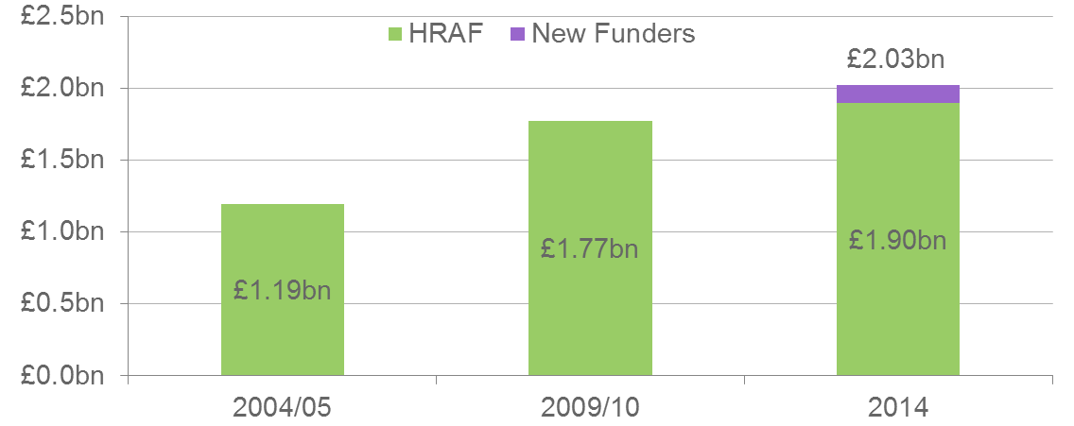
Research Analysis Total Spend
 | 2004/05 | 2009/10 | 2014 (HRAF) | 2014 (All)
Participating organisations | 12 | 12 | 12 | 64
Number of awards coded | 9,901 | 11,482 | 12,696 | 14,934
Value of awards coded (£bn) (real terms) | 1.19 | 1.77 | 1.90 | 2.03
Value of infrastructure funding (£m) (real terms) | N/A | 895 | 952 | 984
Notes:
Presentation notes:
The first UK Health Research Analysis (2004/05) involved the HRAF funders group, and only assessed coded awards directly funding research. Just under ten thousand awards were assessed and a total spend of £950m was reported. This equates to £1.2bn in ‘real terms’, i.e. 2014 prices.
The second analysis (2009/10) involved the same funders and showed a 50% increase in direct funding since 2004/05 (to £1.6bn, £1.77bn in real terms). The second analysis also introduced an assessment of spending on infrastructure, i.e. the indirect spending that support health research, totalling £827m (£895m in real terms).
The current analysis (2014) expanded the number of participating funders to 64. These include 48 medium to smaller AMRC member charities, two more research councils (NERC and AHRC), NC3Rs and Innovate UK. The addition of new funders makes direct comparison with previous analyses difficult, therefore we present all data from the 2014 analysis for both All Funders and the original HRAF Funders.
The amount spent by HRAF funders has increased in 2014 (+£130m since 2009/10), suggesting a much slower rate of growth vs. 2004/05. Compound annual growth rate (CAGR) in health research expenditure 2004-2009 was 8.2%, 2009-2014 it was just 1.4%. Inclusion of the 52 new funders adds a further £130m to the direct research spend.
The assessment of infrastructure and other supportive funding was clarified and expanded in 2014, and is therefore not directly comparable with the 09/10 assessment. In total HRAF funder expenditure on infrastructure was £952m, with another £32m from the 52 new funders. This brings the total health research expenditure assessed in 2014 to £3.01bn.
Further information:
Further details of the UK Health Research Analysis and the underlying Health Research Classification System can be found on the UKCRC website: http://www.ukcrc.org/activities/coordinatingresearchfunding/ukhealthresearchanalysis.aspx
A copy of the all Health Research Analyses can be downloaded from:
http://www.hrcsonline.net/pages/reports
Or contact the UKCRC Secretariat at info@ukcrc.org, phone 0207 670 5294.

Slide 4
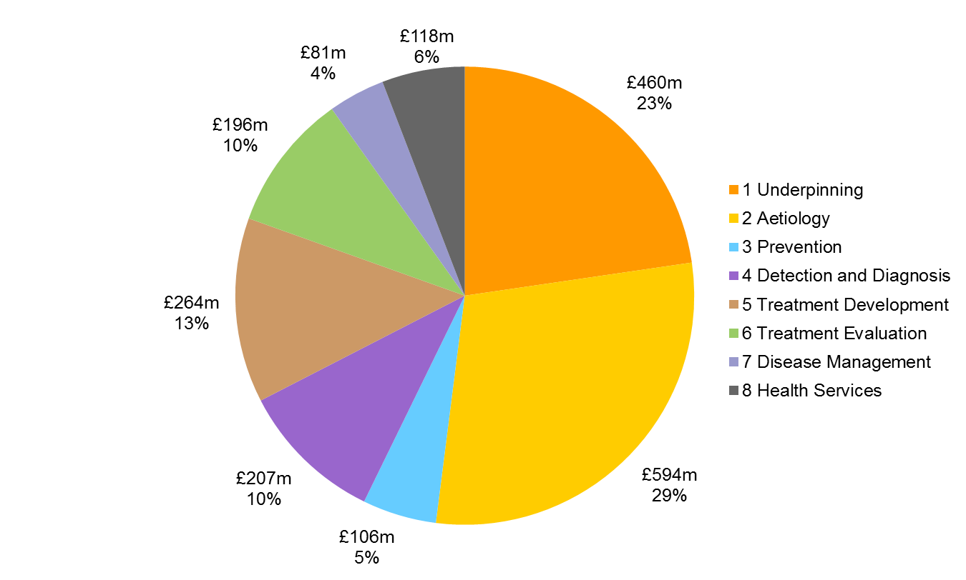
HRCS Research Activities 2014
Notes:
Presentation notes:
The figure is based on combined data from the 64 government and charity funders of health research in the UK and is an overview of their directly funded peer reviewed research taking place during 2014. It shows the distribution of the collective research portfolio of the funders across the eight major Research Activity Codes of the Health Research Classification System.
Approximately half of the funding is in Underpinning (23%) and Aetiology (29%). Underpinning research is aimed at understanding normal biological, psychological and socioeconomic processes and functioning. The Aetiology category includes research into the risk or cause and development of ill health and diseases. This category comprises biological, environmental, psychological and socioeconomic factors involved in disease processes. Most epidemiological studies are included in this category.
The Prevention (5%) category contains research into the primary prevention of disease or conditions, or promotion of well-being. This encompasses behavioural and environmental interventions, vaccine development, nutrition and chemoprevention. The participating funding bodies spend 10% of their combined directly funded research in Detection and Diagnosis which encompasses the discovery, development and evaluation of markers, methods and imaging technologies.
Research into treatments and therapeutic interventions has been divided into Treatment Development (13%) and Treatment Evaluation (10%). Both of these research areas contain all types of therapeutic interventions from pharmaceuticals to behavioural and physical therapies. Treatment Development includes discovery, development and testing in model and preclinical systems. Treatment Evaluation involves testing and evaluation of interventions in humans in clinical or applied settings and therefore includes all therapeutic trials.
Disease Management (4%) is focused at the individual patient level, encompassing individual care needs of service users such as quality of life, treatment compliance, self management and end of life care issues. It also includes studies into all aspects of management by health and social care professionals and contains much of primary care research. Health Services (6%) includes research investigating health and social care service delivery and organisation, health and welfare economics and policy.
Further information:
Further details of the UK Health Research Analysis and the underlying Health Research Classification System can be found on the UKCRC website: http://www.ukcrc.org/activities/coordinatingresearchfunding/ukhealthresearchanalysis.aspx
A copy of the all Health Research Analyses can be downloaded from:
http://www.hrcsonline.net/pages/reports
Or contact the UKCRC Secretariat at info@ukcrc.org, phone 0207 670 5294.

Slide 5
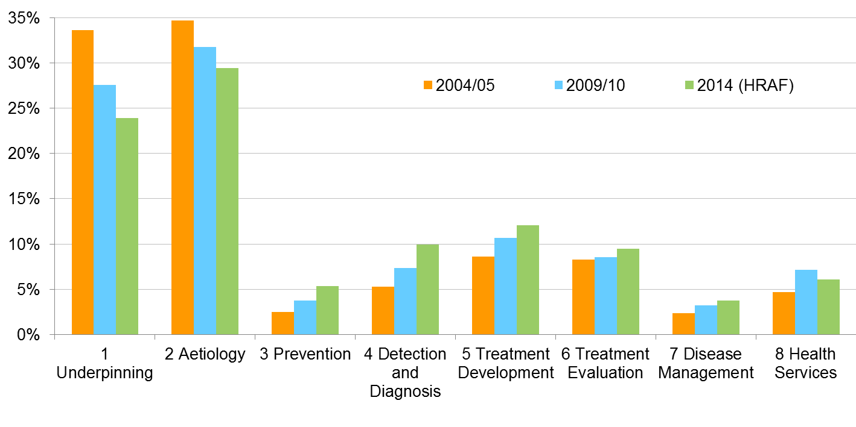
Changes in Research Activity 2004-2014
Notes:
Presentation notes:
This figure shows the distribution of the collective research portfolio of the HRAF funders across the eight major Research Activities of the Health Research Classification System.
The data for this figure is from the proportion of combined spend from the 12 largest government and charity funders of health research in the UK during the 2004/2005, 2009/10 and 2014 reporting periods.
It shows that the proportion of funding for Underpinning and Aetiology have fallen over the last ten years, with a subsequent increase in other research activities, primarily in Prevention, Detection and Diagnosis and Treatment Development.
This change in funding allocation is the result in changes funding strategies to promote the translation of health research from basic science to clinical applications.
There have also been significant changes in national policy to promote funding in certain areas of research shortfalls. A prime example of this is the National Prevention Research Initiative (NPRI) established to bolster Prevention spending.
Please note that due to increases in the total funding available, all eight research activities have shown increased real terms funding between 2004 to 2014. It is only the pattern of funding proportions that has changed in this time period.
Further information:
Further details of the UK Health Research Analysis and the underlying Health Research Classification System can be found on the UKCRC website: http://www.ukcrc.org/activities/coordinatingresearchfunding/ukhealthresearchanalysis.aspx
A copy of the all Health Research Analyses can be downloaded from:
http://www.hrcsonline.net/pages/reports
Or contact the UKCRC Secretariat at info@ukcrc.org, phone 0207 670 5294.

Slide 6
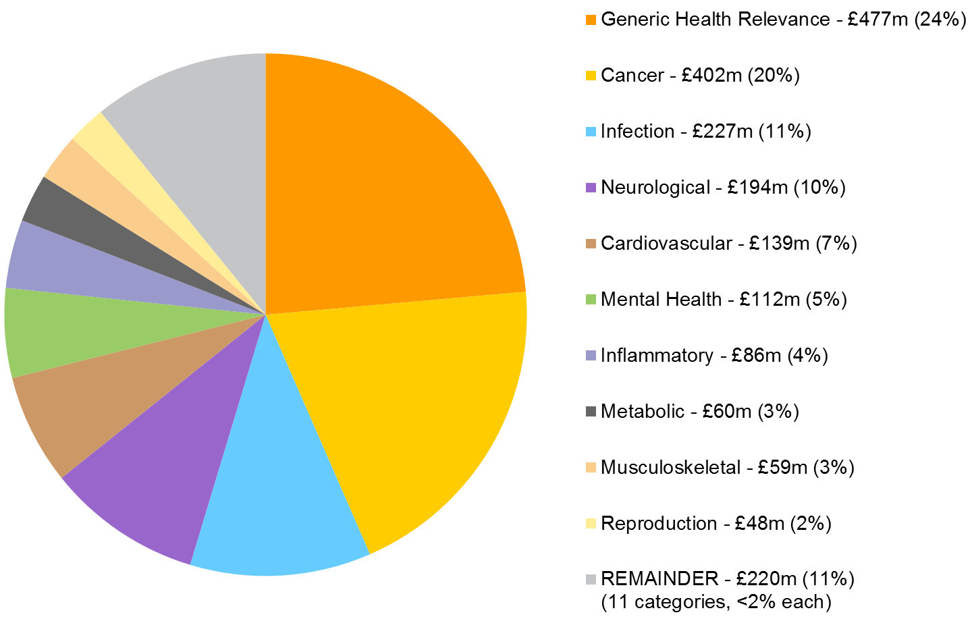
HRCS Health Categories 2014
Notes:
Presentation notes:
This figure is based on combined data from the 64 participating funders and is an overview of their directly funded peer reviewed research taking place in the UK during 2014.
The 21 Health Categories of the Health Research Classification System are based on the International Classification of Diseases (ICD) codes, with some modifications. The proportions in the figure are ordered by amount and displays the 10 largest categories, all of which receive more than 2% of total funds.
Generic Health Relevance receives the most funding and accounts for 24% of total funds. Awards coded as Generic Health Research are applicable to all diseases and/or are relevant to general health.
Cancer, which includes all types of cancers, is ranked second in proportion of expenditure, receiving 20% of total funds.
The next eight categories, Infection, Neurological, Cardiovascular, Mental Health, Inflammatory and Immune System, Metabolic and Endocrine, Musculoskeletal and Reproductive Health and Childbirth, account for 45% of the aggregate health specific funds.
The remaining 11 categories each receive less than 2% of total funding. The amount funded ranges from £36m (1.9%) to £9m (0.3%). These include (in order of funding total); Oral and Gastrointestinal, Respiratory, Stroke, Eye, Renal and Urogenital, Other, Blood, Congenital Disorders, Skin, Ear and Injuries and Accidents.
Further information:
Further details of the UK Health Research Analysis and the underlying Health Research Classification System can be found on the UKCRC website: http://www.ukcrc.org/activities/coordinatingresearchfunding/ukhealthresearchanalysis.aspx
A copy of the all Health Research Analyses can be downloaded from:
http://www.hrcsonline.net/pages/reports
Or contact the UKCRC Secretariat at info@ukcrc.org, phone 0207 670 5294.

Slide 7
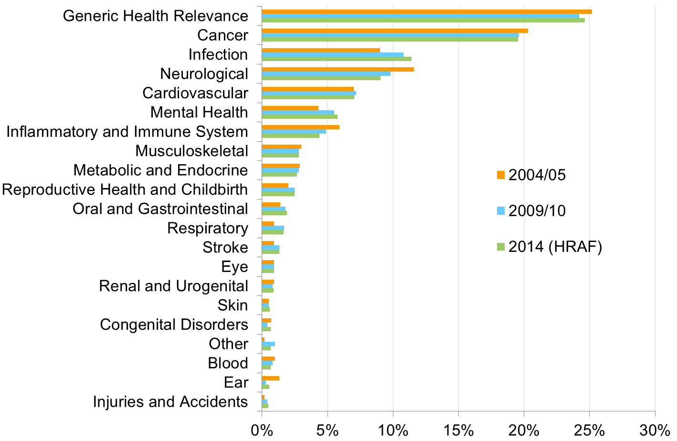
Changes in Health Category 2004-2014
Notes:
Presentation notes:
This figure shows the distribution of the collective research portfolio of the HRAF funders across the 21 Health Categories of the Health Research Classification System. The data for this figure is from the proportion of combined spend from the 12 largest government and charity funders of health research in the UK during the 2004/2005, 2009/10 and 2014 reporting periods.
It shows that the proportion of funding remains relatively stable in most categories. Small decreases are seen in the proportion Generic Health Relevance, Cancer and Inflammatory and Immune System.
Infection saw the largest increase in proportion (+2.4%), possibly due to renewed emphasis on addressing the challenge of anti-microbial resistance.
Research on Mental Health also increased as a proportion of overall spend (+1.5%), whilst a lower proportion of overall spend was allocated to Neurological diseases (-2.5%).
Please note that due to increases in the total funding available, almost all health categories have shown increased real terms funding between 2004 to 2014. It is only the pattern of funding proportions that has changed in this time period. The one exception to this pattern is Ear, which includes studies of the ear and hearing. This category saw a small decrease in real terms funding in this time period, due to changes in a small number of awards.
Further information:
Further details of the UK Health Research Analysis and the underlying Health Research Classification System can be found on the UKCRC website: http://www.ukcrc.org/activities/coordinatingresearchfunding/ukhealthresearchanalysis.aspx
A copy of the all Health Research Analyses can be downloaded from:
http://www.hrcsonline.net/pages/reports
Or contact the UKCRC Secretariat at info@ukcrc.org, phone 0207 670 5294.

Slide 8
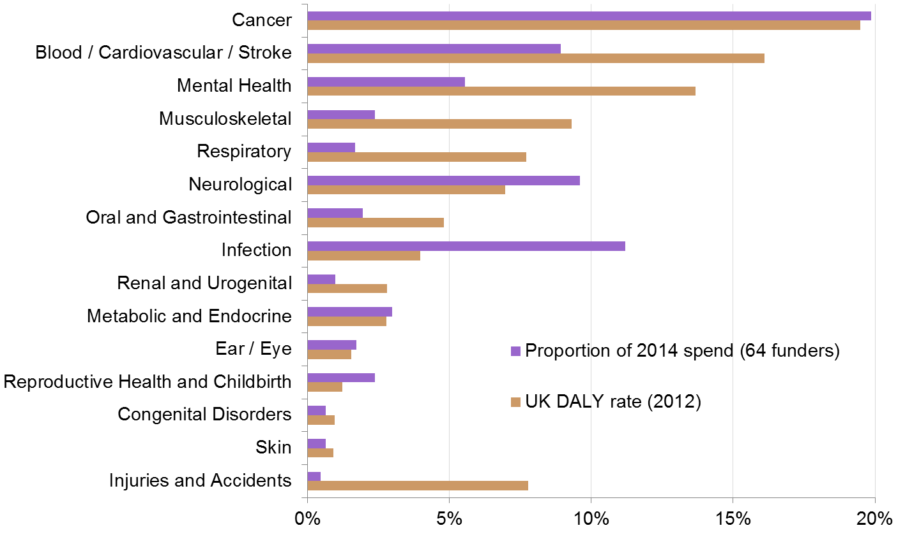
Burden of Disease Comparison
Notes:
Presentation notes:
This figure is based on 2014 combined data from all 64 funders compared to the proportion of research funding across health-specific categories (shown in purple) to UK Disability Adjusted Life Years (DALY) rates (shown in brown) from the WHO Global Burden of Disease Project*. In the figure, selected Health Categories from the UKCRC’s Health Research Classification System have been combined as necessary to allow appropriate comparison with the available DALY data. Data is displayed in order of DALY rate, excluding Injuries and Accidents.
DALYs are frequently used as a measure of burden of disease. DALYs are a measure of the sum of life years lost due to premature mortality and years lived with a disability adjusted for its severity, and thus they take into account the impact of mortality and morbidity in a single measure.
Trends in the ranking of research funding correlate relatively poorly with the overall trend in the DALY ranking. The three areas with the highest UK burden of disease - Cancer, Blood/Cardiovascular/Stroke and Mental Health - are ranked 1st, 4th and 5th in research funding, with Infection and Neurological spend considerably higher than their comparative burden of disease.
However, it is important to note that the mapping of HRCS Health Categories and WHO disease codes is imperfect, with no corresponding codes for Generic Health Relevance, Inflammatory and Immune System or Other. Therefore only 71% of funding can be compared in this way.
In addition, the research costs for a specific disease may not correlate with the morbidity/mortality that condition imposes on a population. For example Injuries and Accidents account for a large proportion of burden of disease, but research is limited to improving treatments (e.g. for fractures, burns, poisons) or intervention studies to prevent future accidents.
Further information:
Further details of the UK Health Research Analysis and the underlying Health Research Classification System can be found on the UKCRC website: http://www.ukcrc.org/activities/coordinatingresearchfunding/ukhealthresearchanalysis.aspx
A copy of the all Health Research Analyses can be downloaded from:
http://www.hrcsonline.net/pages/reports
Or contact the UKCRC Secretariat at info@ukcrc.org, phone 0207 670 5294.
* WHO Global Burden of Disease Project – Estimates for 2000-2012 – DALY by country 2012 (all ages). http://www.who.int/healthinfo/global_burden_disease/estimates/en/index2.html

Slide 9
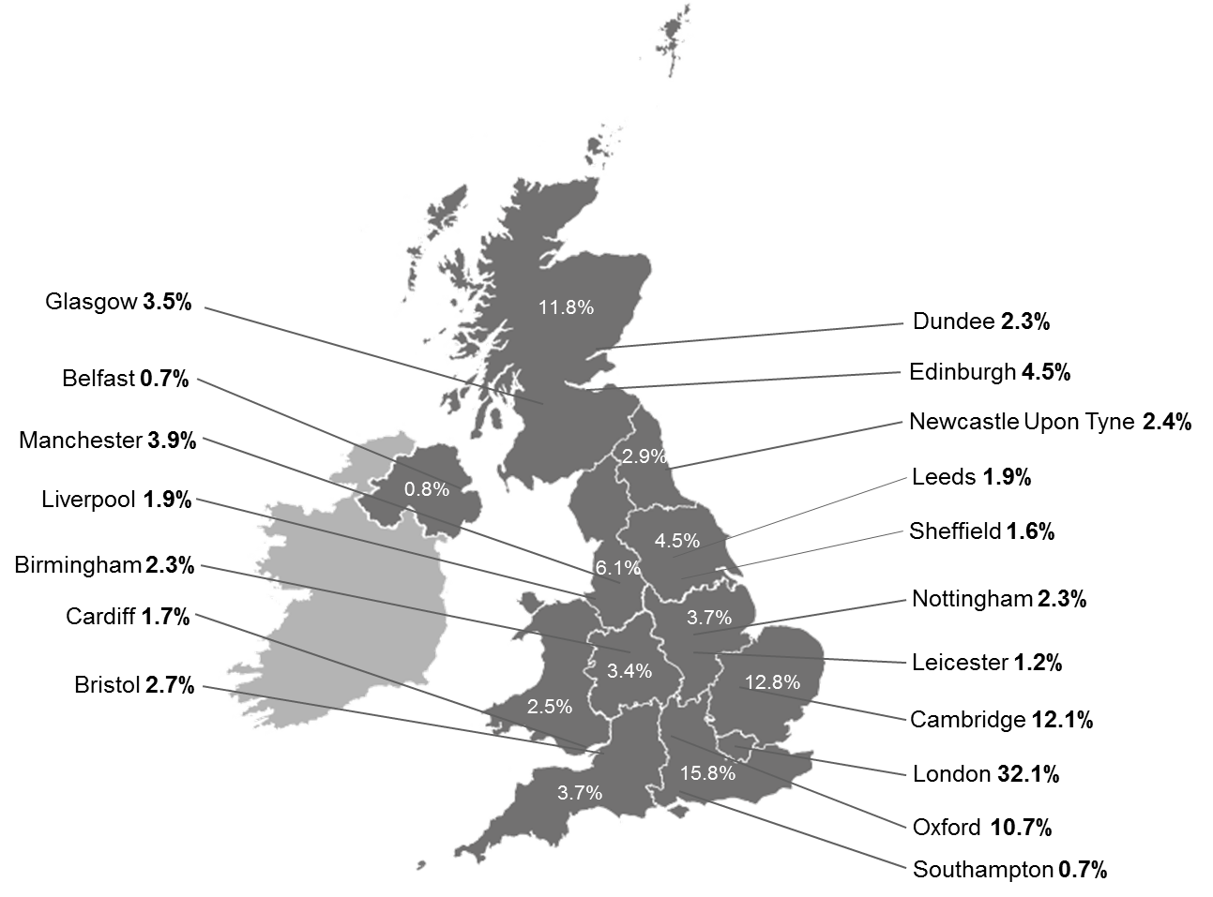
HRCS Geographic Distribution 2014
Notes:
Presentation notes:
This figure is based on combined data from the 64 government and charity funders of health research in the UK and is an overview of their directly funded peer reviewed research taking place during 2014.
The map shows the distribution of the collective research portfolio of the funders across geographical location within the United Kingdom.
The figure shows a breakdown of funding by individual cities (for presentation reasons, it excludes cities where the proportion of funds is less than 1% of the total). The proportion of total spend within each UK region is also shown.
Further information:
Further details of the UK Health Research Analysis and the underlying Health Research Classification System can be found on the UKCRC website: http://www.ukcrc.org/activities/coordinatingresearchfunding/ukhealthresearchanalysis.aspx
A copy of the all Health Research Analyses can be downloaded from:
http://www.hrcsonline.net/pages/reports
Or contact the UKCRC Secretariat at info@ukcrc.org, phone 0207 670 5294.

Slide 10
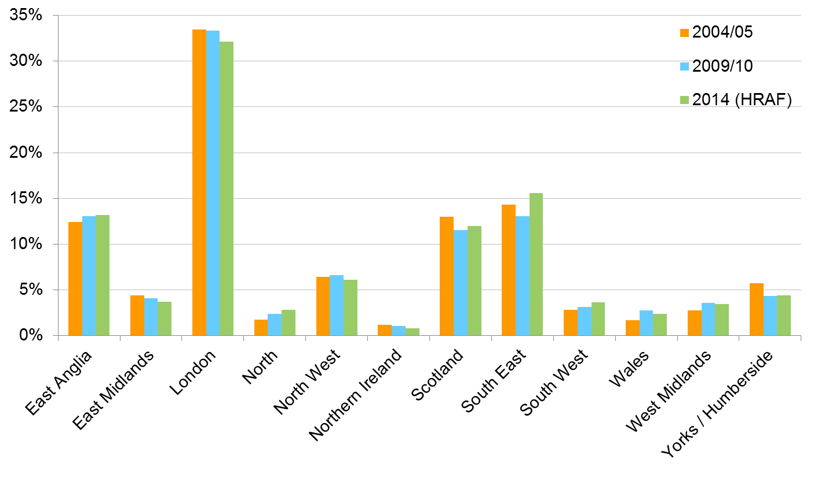
Changes in UK Distribution 2004-2014
Notes:
Presentation notes:
This figure shows the distribution of the collective research portfolio across the regions of the UK. The data for this figure is from the proportion of combined spend from the 12 largest government and charity funders of health research in the UK during the 2004/2005, 2009/10 and 2014 reporting periods.
It shows that the proportion of funding remains relatively stable in most regions.
London still accounts for approximately one third of UK health research spend, but has decreased slightly in the ten year period (-1.4%).
South East (including Oxford), East Anglia (including Cambridge) and Scotland (including Edinburgh) share approximately 40 per cent of UK funding (between 11% and 16% each). Of these funding in the South East has increased slightly (+1.5%) whilst Scotland’s funding has decreased slightly (-1.2%).
Please note that due to increases in the total funding available, all UK regions have shown increased real terms funding between 2004 to 2014. It is only the pattern of funding proportions that has changed in this time period.
Further information:
Further details of the UK Health Research Analysis and the underlying Health Research Classification System can be found on the UKCRC website: http://www.ukcrc.org/activities/coordinatingresearchfunding/ukhealthresearchanalysis.aspx
A copy of the all Health Research Analyses can be downloaded from:
http://www.hrcsonline.net/pages/reports
Or contact the UKCRC Secretariat at info@ukcrc.org, phone 0207 670 5294.

Slide 11
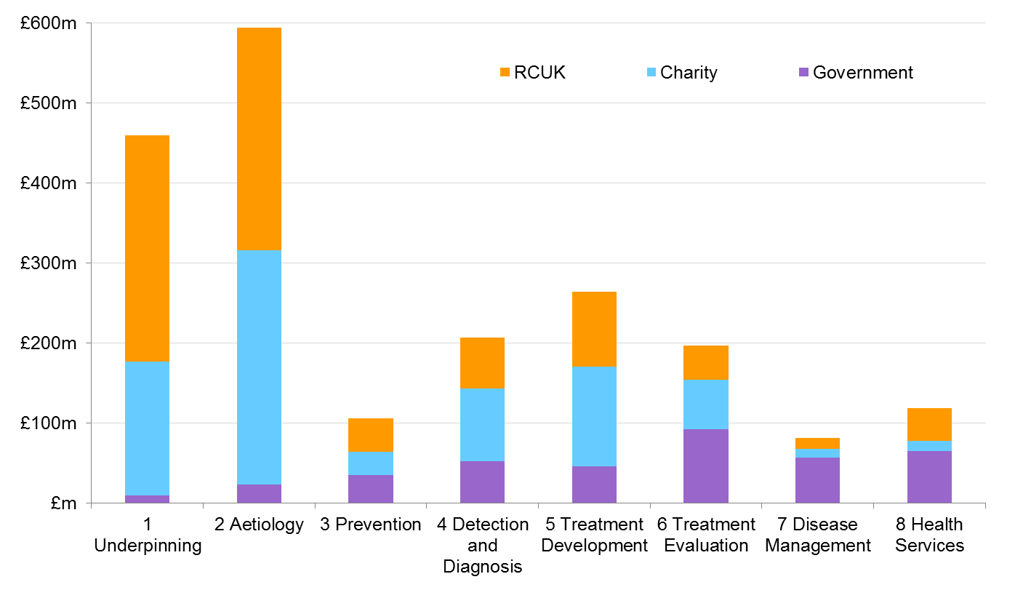
HRCS Sector Distribution 2014 (RA)
Notes:
Presentation notes:
This figure shows the distribution of the collective research portfolio for all 64 funders across the research activity groups, segregated by funding sector. This comparison is new to the UK Health Research Analysis report series in 2014.
Charity sector funding constitutes all 52 medical research charities. Public sector funding is subdivided by RCUK (research councils; MRC, BBSRC, EPSRC, ESRC, NERC, AHRC) and Government (Health Departments, Innovate UK, NC3Rs).
Charitable funders provide nearly half of all funding in Aetiology, Detection and Diagnosis and Treatment Development (49, 44 and 47% respectively) which is consistent with their focus in determining the causes of disease and developing new strategies for both early diagnosis and novel treatments.
Research Council funding supports Aetiology (49%) but also contributes over half of the basic research within Underpinning (62%), consistent with research council focus on discovery science.
Government funders have a more patient/treatment focused portfolio, with a relatively small proportion (<4%) of research in Underpinning or Aetiology, and therefore provide the majority of funding in Treatment Evaluation,
Disease Management and Health Services (47, 70, 54% respectively).
Further information:
Further details of the UK Health Research Analysis and the underlying Health Research Classification System can be found on the UKCRC website: http://www.ukcrc.org/activities/coordinatingresearchfunding/ukhealthresearchanalysis.aspx
A copy of the all Health Research Analyses can be downloaded from:
http://www.hrcsonline.net/pages/reports
Or contact the UKCRC Secretariat at info@ukcrc.org, phone 0207 670 5294.

Slide 12
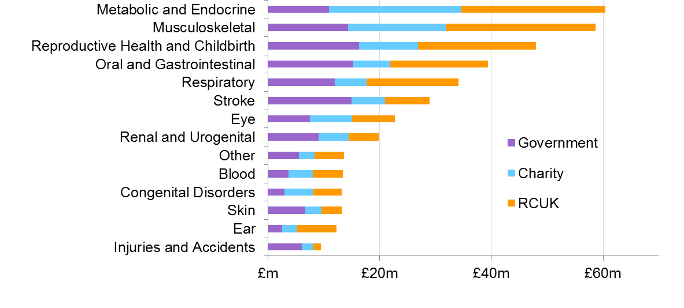
HRCS Sector Distribution 2014 (HC)
Notes:
Presentation notes:
This figure shows the distribution of the collective research portfolio for all 64 funders across the health categories, segregated by funding sector. This comparison is new to the UK Health Research Analysis report series in 2014.
This figure is split into two panels to show the largest seven categories (funding >£60m, top panel) and smaller 14 categories (funding <£60m, bottom panel) more clearly.
Charity sector funding constitutes all 52 medical research charities. Public sector funding is subdivided by RCUK (research councils; MRC, BBSRC, EPSRC, ESRC, NERC, AHRC) and Government (Health Departments, Innovate UK, NC3Rs).
Research Councils support the majority of Generic Health Research (64%), which is often used in conjunction with Underpinning in studies of basic biological processes.
Charities support the majority of funding for Cancer (£299m, 74%), primarily by Cancer Research UK (84%, £252m) although 12 of the 48 medium to smaller charities also have an exclusively cancer-based portfolio. Similarly 60 per cent (£82.5m) of all Cardiovascular funding is by charities, primarily by the British Heart Foundation (86%, £70.8m).
Correlation analysis showed charities, research councils and Government funders all prioritise in similar ways (Spearman’s coefficients 0.91 to 0.97). The reasons for this correlation are unclear but may relate to similar strategic priorities in public funding and the capacity for funding in certain areas.
Further information:
Further details of the UK Health Research Analysis and the underlying Health Research Classification System can be found on the UKCRC website: http://www.ukcrc.org/activities/coordinatingresearchfunding/ukhealthresearchanalysis.aspx
A copy of the all Health Research Analyses can be downloaded from:
http://www.hrcsonline.net/pages/reports
Or contact the UKCRC Secretariat at info@ukcrc.org, phone 0207 670 5294.

Slide 13
Overall UK health research spend
UK Health Research Analysis ‘bottom up’ assessment vs. total UK health relevant expenditure ‘top down’ estimate
2014 Analysis showed a combined spend (direct research + infrastructure) of £3.01bn
Estimation of funding from additional sources adds a further £1bn
Comparison with total UK health research expenditure estimate (£8.5bn) shows ~47% of all UK health research expenditure accounted for.
Comparison with estimation in 2009/10 shows UK health research spending shrank by £780m, largely from decrease in pharmaceutical industry expenditure.
Performing Sector | 2009/10 (£bn) (real terms) | 2013/14 (£bn) | Difference (£m)
Business | 4.8 | 4.1 | -700
Private non-Profit (PNP) | 0.4 | 0.4 | +10
University | 2.5 | 2.7 | +210
Public Sector Research Institutes | 1.6 | 1.3 | -300
TOTAL | 9.3 | 8.5 | -780
Notes:
Presentation notes:
The UK Health Research Analyses constitute a ‘bottom up’ estimate of public and charitable funding. In the 2009/10 and 2014 reports, this was compared against an estimate of overall UK health relevant expenditure.
This estimate requires a ‘top down’ calculation based on total R&D funding in the UK, provided by the Office for National Statistics in the form of the Gross Expenditure on Research and Development (2013).
This provides values for R&D expenditure for all performing sectors, but does not segregate by R&D type. See Appendix 4 of the 2014 analysis for full details of how a health relevant proportion of these totals were calculated.
The 2014 Analysis showed a combined spend on direct research of £2.03bn and a further £985m on infrastructure.
An assessment of additional sources of support funding was also carried out. This includes other Government support programmes, such as the Charity Research Support Fund, QQR funding, and NHS support for clinical academics. While outside of the normal scope of the analysis, these additional funding sources provide another £1bn in funding to UK health research.
Taken together, more than £4bn of spending can be accounted for in this analysis. Compared to the estimation of total UK health relevant expenditure, the 2014 analysis accounts for almost half of this total (47%). If business spending (£4.1bn) is excluded, the 2014 analysis accounts for 91% of all public/charitable funding for UK health research.
Comparison of estimates for total UK health expenditure from 2009/10 and 2014 suggests an overall decrease in health R&D spending in the last five years (approx. -£780m). The majority of this decrease comes from reduced spending in the pharmaceutical industry (-£700m).
Further information:
Further details of the UK Health Research Analysis and the underlying Health Research Classification System can be found on the UKCRC website: http://www.ukcrc.org/activities/coordinatingresearchfunding/ukhealthresearchanalysis.aspx
A copy of the all Health Research Analyses can be downloaded from:
http://www.hrcsonline.net/pages/reports
Or contact the UKCRC Secretariat at info@ukcrc.org, phone 0207 670 5294.

